Slide 1
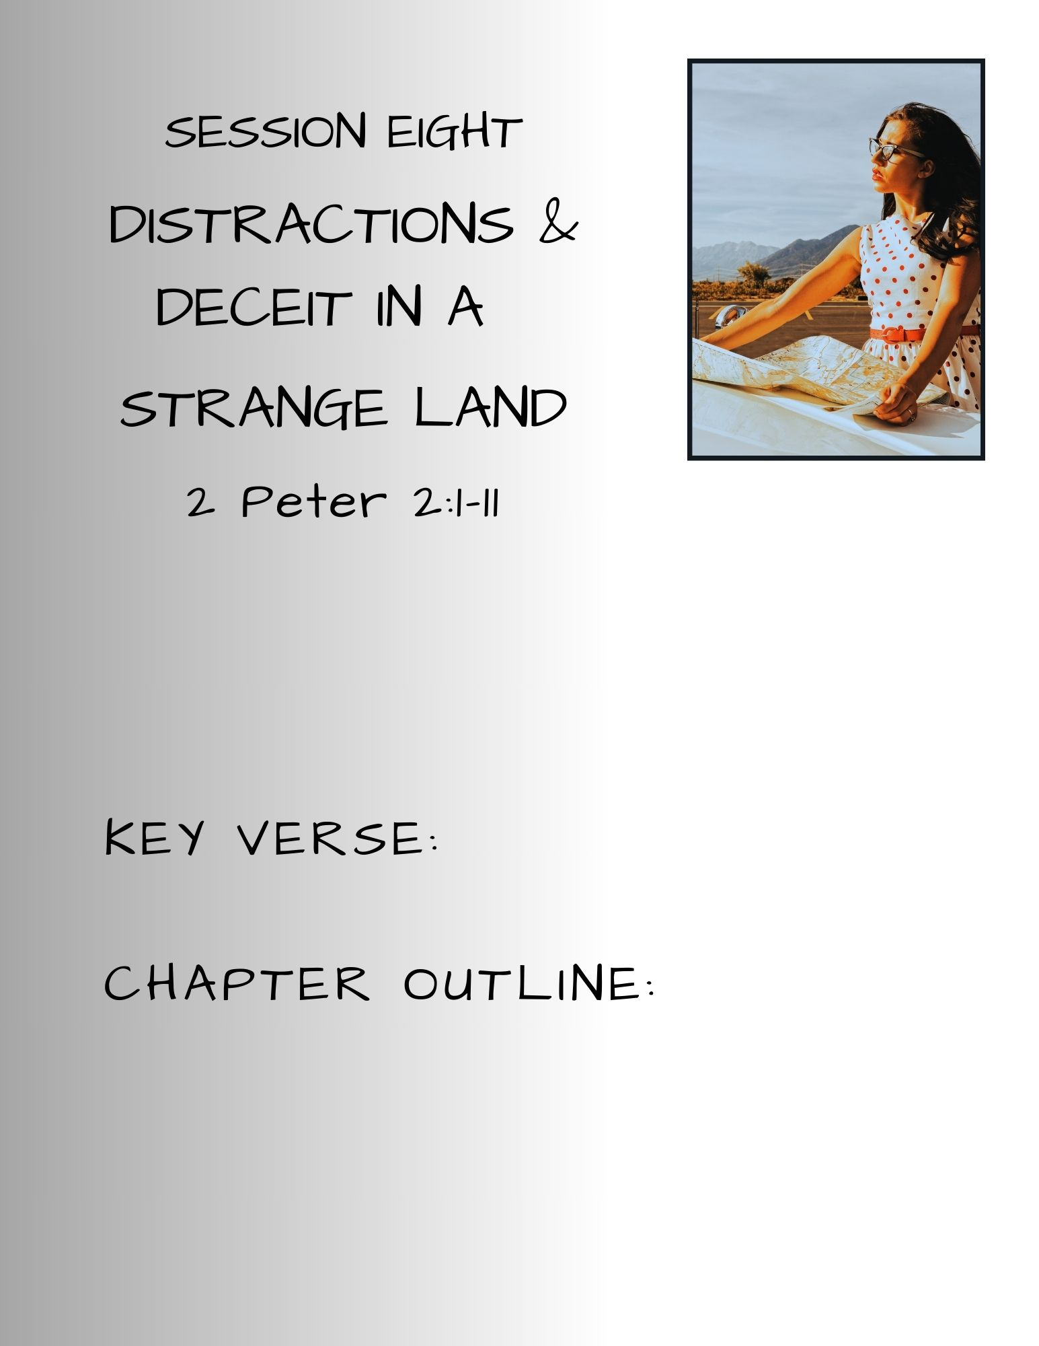

Slide 2
SESSION 8 Distractions & Deceit In A Strange Land
Session 7 Recap – Willing Stranger
Rebekah: Packing For The Journey
  An interruption may be a divine invitation to participate in God’s work.
  Rebekah was God’s answer to Abraham’s servant’s prayer –
  You may be God’s answer to
  someone else’s prayer.
Second Peter Chapter 1 – Summary
  Your identity in Christ Jesus
  God equips you for your calling
  You have a living hope and eternal promise
      confirmed by eyewitnesses to the TRUTH
  You are to exercise & grow your faith & its fruits
  You are to be the light in the darkness

Slide 3


SESSION 7 – Willing Stranger
Prelude: Dinah – Pitfalls & Perils
Genesis 34:1-31
Wanting to Belong
  She wanted to see how the “women of the land” lived
  She was the only daughter of 12 sons
  She was the daughter of Leah, the unloved wife
  She was a daughter in a culture that valued sons most highly
  Bored? Dissatisfied? Looking for Love? Acceptance?
Deceit & Deception – the players
  Simeon and Levi
  Hamor’s greedy motives
  Jacob’s indifference
  Shechem
Notes:
Negative connotation: “women of the land” Rebekah to Isaac Genesis 27:46 I loathe my life because of the Hittite women. If Jacob marries on the Hittite women like these-ONE OF THE WOMEN OF THE LAND, what god will my life be to me?
Dinah was the last child (of the 6 sons) born to Leah – Jacob’s unloved wife (Genesis 30:19) Leah 6 sons, 1 daughter; Zilpah – 2 sons, Rachel – Bilhah 2 sons, then Joseph and Benjamin
After each son was born to Leah – she announced the son’s name and that the child was a blessing from God that would cause her husband, Jacob to honor and love her
Nothing is announced after Dinah – no significance to her name, no thanksgiving to God
Dinah’s life afterward – all we know for certain is that she was with the family went they went to Egypt GEN 46:15 – Dinah - listed as daughter of Leah – all the brothers and their children listed, Dinah listed alone
Multiple stories in Jewish writings speculate about Dinah’s final years – married an Egyptian prince, married her brother Simeon, all speculation

Slide 4
SESSION 8 Distractions & Deceit In A Strange Land
Pseudo Prophets & Phony Prophecies
KEY VERSE
“They promise them freedom,
but they themselves are slaves of corruption.
For whatever overcomes a person,
to that he is enslaved.”
2 Peter 2:19 ESV
Notes:
Peter concluded Chapter 1, with a defending the validity and truth of his and the apostles message – they were eyewitnesses, they walked and talked with Jesus during His earthly ministry AND after His death, burial and resurrection.
UNLIKE the false teachers
2 Peter 1:16-21
¹⁶ For we did not follow cleverly devised myths when we made known to you the power and coming of our Lord Jesus Christ, but we were eyewitnesses of his majesty. ¹⁷ For when he received honor and glory from God the Father, and the voice was borne to him by the Majestic Glory, "This is my beloved Son, with whom I am well pleased," ¹⁸ we ourselves heard this very voice borne from heaven, for we were with him on the holy mountain.
¹⁹ And we have the prophetic word more fully confirmed, to which you will do well to pay attention as to a lamp shining in a dark place, until the day dawns and the morning star rises in your hearts, ²⁰ knowing this first of all, that no prophecy of Scripture comes from someone's own interpretation. ²¹ For no prophecy was ever produced by the will of man, but men spoke from God as they were carried along by the Holy Spirit.“

Slide 5
SESSION 8 Distractions & Deceit In A Strange Land
Traveler Beware – 2 Peter 2:1-3
¹ But false prophets also arose among the people, just as there will be false teachers among you, who will secretly bring in destructive heresies, even denying the Master who bought them, bringing upon themselves swift destruction.
² And many will follow their sensuality, and because of them the way of truth will be blasphemed. ³ And in their greed they will exploit you with false words. Their condemnation from long ago is not idle, and their destruction is not asleep.
  BUT...False Prophets:
  Wolves in sheep’s clothing – Matt. 7:15
  Deny or attempt to redefine Christ
  Lies & False visions – Lam.2:14, Ez. 13:9, 22:28
  Promote sensual, immoral practices
  Exploit their followers
Notes:
BUT V.1 – But false prophets also arose among the people (reference to the false prophets of the OT),
Lamentations 2:14 ESV - Your prophets have seen for you false and deceptive visions; they have not exposed your iniquity to restore your fortunes, but have seen for you oracles that are false and misleading.
Ezekiel 13:9 ESV - My hand will be against the prophets who see false visions and who give lying divinations. They shall not be in the council of my people, nor be enrolled in the register of the house of Israel, nor shall they enter the land of Israel. And you shall know that I am the Lord GOD.
Ezekiel 22:28 ESV - And her prophets have smeared whitewash for them, seeing false visions and divining lies for them, saying, 'Thus says the Lord GOD,' when the LORD has not spoken.
just as there will be false teachers among you, who will secretly bring in destructive heresies (reference to the deceptive and destructive, ruinous nature of the prophecies), even denying the Master (Jesus) who bought them (Christ died for all on the cross – He purchased our salvation with His blood – BUT it is not forced upon anyone – and if it is rejected or accepted under any terms besides God’s, salvation was not received/applied), bringing upon themselves swift destruction (to perish, ruin, death, waste).
False claims of being believers – apostates who brough judgment upon themselves
V.2 – And many will follow their sensuality (the message of the false prophets is seductive, appealing, enticing – many of the new believers came out of idol worship which included sensual/sexual/immoral practices in its worship). Because of them (the false prophets) the way of truth will be blasphemed (spoken evil of, railed on, reviled, reproached).
G766 – sensuality: unbridled lust, excess, licentiousness, lasciviousness, outrageousness, wantonness, shamelessness, insolence
Merriam-Webster: Sensuality – relating to or consisting in the gratification of the senses or the indulgence of appetite; sensory; devoted to or preoccupied with the senses or appetites; voluptuous; deficient in moral, spiritual, or intellectual interests
V.3 – And in their greed (avarice, extreme greed, , they will exploit you (use you, trying to get you to “buy” into, tricked into agreeing with) with false words (lies). Their condemnation (judgment, the sentence of a judge, the punishment in a guilty sentence), from long ago (of old, a long time) is not idle (not to be delayed), and their destruction (to perish, ruin, death, waste) is not asleep (delayed or slumbering).
NIV-“And through covetousness shall they with feigned words make merchandise of you: whose judgment now of a long time lingereth not, and their damnation slumbereth not.” 2:3
CHRIST’S WARNINGS
Matthew 7:15 ESV - "Beware of false prophets, who come to you in sheep's clothing but inwardly are ravenous wolves.
Matthew 24:11 ESV - And many false prophets will arise and lead many astray.
Matthew 24:24 ESV - For false christs and false prophets will arise and perform great signs and wonders, so as to lead astray, if possible, even the elect.
Mark 13:22 ESV - For false christs and false prophets will arise and perform signs and wonders, to lead astray, if possible, the elect.
1 John 4:1 ESV - Beloved, do not believe every spirit, but test the spirits to see whether they are from God, for many false prophets have gone out into the world.

Slide 6
SESSION 8 Distractions & Deceit In A Strange Land
Traveler Beware – 2 Peter 2:4-8
⁴ For if God did not spare angels when they sinned, but cast them into hell and committed them to chains of gloomy darkness to be kept until the judgment;
⁵ if he did not spare the ancient world, but preserved Noah, a herald of righteousness, with seven others, when he brought a flood upon the world of the ungodly;
⁶ if by turning the cities of Sodom and Gomorrah to ashes he condemned them to extinction, making them an example of what is going to happen to the ungodly;
⁷ and if he rescued righteous Lot, greatly distressed by the sensual conduct of the wicked ⁸ (for as that righteous man lived among them day after day, he was tormenting his righteous soul over their lawless deeds that he saw and heard);
  GOD DID NOT SPARE:
  Rebellious Angels
  The ancient world pre-flood –Noah & family preserved
  Sodom & Gomorrah – Lot & family preserved (wife)
Notes:
V.4 ⁻ For if God did not spare angels (rebelled against God along with Satan) when they sinned, but cast them into hell and committed them to chains of gloomy darkness to be kept until the judgment;
V.5 ⁻ if he did not spare the ancient world, but preserved Noah, a herald of righteousness, with seven others, when he brought a flood upon the world of the ungodly;
V.6 - if by turning the cities of Sodom and Gomorrah to ashes he condemned them to extinction, making them an example of what is going to happen to the ungodly;
V.7- and if he rescued righteous Lot, greatly distressed by the sensual conduct of the wicked ⁸ (for as that righteous man lived among them day after day, he was tormenting his righteous soul over their lawless deeds that he saw and heard)
Lot may have been greatly distressed by the sins of Sodom and Gomorrah, but not enough to do something about it! In the end, his wife’s heart belonged to Sodom, and later Scripture indicates his daughters hearts carried Sodom with them even as they fled the burning city

Slide 7
SESSION 8 Distractions & Deceit In A Strange Land
Traveler Beware – 2 Peter 2:9-10a
⁹ Then the Lord knows how to rescue the godly from trials, and to keep the unrighteous under punishment until the day of judgment, ¹⁰ and especially those who indulge in the lust of defiling passion and despise authority.
Rescue for the godly:
Daniel in the lions’ den (Daniel Chapter 6)
Shadrach, Meshach, & Abednego in the fiery furnace (Daniel Chapter 3)
Apostle Paul from persecutions, sufferings, & evil attacks (2 Timothy 3:11, 4:17)
Punishment for the unbelievers –
  Those who pursue or chase after the lusts (cravings,
    longings, desires) of corrupting & polluting
  Those who hate to submit to any higher power
Notes:
V.9 - then the Lord knows how to rescue the godly from trials [G3986- peirasmos pronounce: pi rus moss – trial, proving, test, enticement to sin, temptation – internal or external] EXAMPLES: Daniel-lion’s den, Shadrach, Meshach, Abednego – fiery furnace, Jonah-whale, Paul & Silas) , and to keep the unrighteous under punishment (punishment doesn’t wait) until the day of judgment,
Luke 16:23-24 ESV –“ and in Hades, being in torment, he lifted up his eyes and saw Abraham far off and Lazarus at his side. And he called out, 'Father Abraham, have mercy on me, and send Lazarus to dip the end of his finger in water and cool my tongue, for I am in anguish in this flame.” His punishment began after death.
Hebrews 9:27 ESV - And just as it is appointed for man to die once, and after that comes judgment,
V.10a - and especially those who indulge (a bit stronger than we think of it when we say we indulged in a bit of chocolate – end goal is to please the flesh, G4198 – poreuō - to pursue the journey of, to follow after or order one’s life) in the lust (G1939: epithymia: desire, craving, longing, a desire for what is forbidden) of defiling (corrupting, polluting) passion and despise (disdain, dismissive, authority.

Slide 8
SESSION 8 Distractions & Deceit In A Strange Land
Traveler Beware – 2 Peter 2:10b-13
Bold and willful, they do not tremble as they blaspheme the glorious ones, ¹¹ whereas angels, though greater in might and power, do not pronounce a blasphemous judgment against them before the Lord. ¹² But these, like irrational animals, creatures of instinct, born to be caught and destroyed, blaspheming about matters of which they are ignorant, will also be destroyed in their destruction, ¹³ suffering wrong as the wage for their wrongdoing. They count it pleasure to revel in the daytime. They are blots and blemishes, reveling in their deceptions, while they feast with you.
Fearless, Shameless, and Unaware of the Reality of the Situation
Deaf, Blind, and Ignorant to the Consequences of Their
  Choice, Actions, and Bad Decisions
Clueless and Condemned
Notes:
V. 10b - Bold (daring, presumptuous, audacious, reckless, foolhardy) and willful (self-pleasing, self-willed, stubborn, arrogant), they do not tremble (they have no fear!) as they blaspheme (heap abuse (NIV), self-willed, rail at, revile) the glorious ones (celestial beings – G1391 doxa – in the NT always refers to those belonging to God-majestic, excellent, preeminent),
V. 11 - whereas angels, though greater in might and power, do not pronounce a blasphemous judgment against them before the Lord.
V.12 - But these, like irrational animals (brute beasts, functioning in the flesh), creatures of instinct, born to be caught and destroyed, blaspheming about matters of which they are ignorant, will also be destroyed in their destruction (it may look like they are prospering – ex. People prospering as Noah labored over the building the ark, but destruction is coming,
V. 13 - suffering wrong as the wage for their wrongdoing (they will reap what they have sowed).
Job 4:8 ESV - As I have seen, those who plow iniquity and sow trouble reap the same.
Galatians 6:-8 ESV - Do not be deceived: God is not mocked, for whatever one sows, that will he also reap.For the one who sows to his own flesh will from the flesh reap corruption, but the one who sows to the Spirit will from the Spirit reap eternal life.
They count it pleasure to revel in the daytime (they flaunt their sin, they are blatant in their sinning – not trying to hide it- there’s no shame). They are blots and blemishes, reveling in their deceptions (lies, falsehood, misrepresentations), while they feast with you.

Slide 9
SESSION 8 Distractions & Deceit In A Strange Land
Traveler Beware – 2 Peter 2:14-16
¹⁴ They have eyes full of adultery, insatiable for sin. They entice unsteady souls. They have hearts trained in greed. Accursed children! ¹⁵ Forsaking the right way, they have gone astray. They have followed the way of Balaam, the son of Beor, who loved gain from wrongdoing, ¹⁶ but was rebuked for his own transgression; a speechless donkey spoke with human voice and restrained the prophet's madness.
  Insatiable craving for their sin(s) of choice
  Eager to entice others to join their unholy journey
  Practiced – exercised in their greed
  Cursed & Doomed
Notes:
¹⁴ They have eyes full of adultery (literal and figuratively referring to the mind’s eye – it’s on their mind, always looking for), insatiable for sin (they cannot be satisfied, unable to stop, addicted to sin, a burning desire that cannot be quenched). They entice (bait, beguile, deceive, lure, allure), unsteady souls. They have hearts trained in greed (practiced, ingrained, exercised vigorously – like an athlete would train for a meet) Accursed (to be cursed, under a curse) children!
¹⁵ Forsaking the right way, they have gone astray. They have followed the way of Balaam, the son of Beor (Numbers Ch. 22-24, Balak, King of Moab wanted to pay Balaam to curse Israel – Moab was afraid of Israel-their numbers were huge-Israel had already defeated the Amorites, the army of Bashan, and others), to come to who loved gain from wrongdoing, ¹⁶ but was rebuked for his own transgression; a speechless donkey spoke with human voice and restrained the prophet's madness.
Cursed & Doomed UNLESS they recognize and repent of their hopeless state – repentance and salvation

Slide 10
SESSION 8 Distractions & Deceit In A Strange Land
Traveler Beware – 2 Peter 2:17-19
¹⁷ These are waterless springs and mists driven by a storm. For them the gloom of utter darkness has been reserved. ¹⁸ For, speaking loud boasts of folly, they entice by sensual passions of the flesh those who are barely escaping from those who live in error. ¹⁹ They promise them freedom, but they themselves are slaves of corruption. For whatever overcomes a person, to that he is enslaved.
  Romans 6:6 - No Longer Enslaved
  Galatians 4:7-9 – My Chains Are Gone
  Titus 3:3 – Freed from the Snares of Passions
Notes:
¹⁷ These are waterless springs and mists driven by a storm (dry fountains and clouds blown about by a whirlwind or tempestuous wind). For them (the False Prophets from verse 1) the gloom of utter darkness has been reserved.
¹⁸ For, speaking loud boasts of folly, they entice by sensual passions of the flesh those who are barely escaping from those who live in error. ¹⁹ They promise them freedom, but they themselves are slaves of corruption. For whatever overcomes a person, to that he is enslaved. (Bound, trapped, imprisoned by their sins and passions –
Rom 6:6 – no longer enslaved – Romans 6:6 ESV - We know that our old self was crucified with him in order that the body of sin might be brought to nothing, so that we would no longer be enslaved to sin.
Gal 4:7-9 – how can you return to your chains? – Galatians 4:7-9 ESV - So you are no longer a slave, but a son, and if a son, then an heir through God. Formerly, when you did not know God, you were enslaved to those that by nature are not gods. But now that you have come to know God, or rather to be known by God, how can you turn back again to the weak and worthless elementary principles of the world, whose slaves you want to be once more?
Tit 3:3 – slaves to various passions –Titus 3:3 ESV - For we ourselves were once foolish, disobedient, led astray, slaves to various passions and pleasures, passing our days in malice and envy, hated by others and hating one another.

Slide 11
SESSION 8 Distractions & Deceit In A Strange Land
Traveler Beware – 2 Peter 2:17-19
FALSE PROPHET & UNBELIEVER |  | TEACHER OF THE WORD & BELIEVER
Dry Fountains – Empty Clouds |  | Vessels Of Living Waters – John 4:14; 7:38
Darkness Bound |  | Children of Light – 1 Thessalonians 5:5
Loud & Boastful |  | Meek & Humble – Colossians 3:12
Enticers, Seducers, Deceitful & Deceived |  | Truth Tellers – John 3:18-19, 2 John 1:2
Enslaved |  | Freed – Romans 8:2, Galatians 5:1
Notes:
¹⁷ These are waterless springs and mists driven by a storm (dry fountains and clouds blown about by a whirlwind or tempestuous wind – Jeremiah 2:13 God’s disobedient trying to be self-sufficient (not needing God) trusting in their own hand-built cisterns that are broken-incapable of holding water ). For them (the False Prophets from verse 1) the gloom of utter darkness has been reserved.
¹⁸ For, speaking loud boasts of folly, they entice by sensual passions of the flesh those who are barely escaping from those who live in error. ¹⁹ They promise them freedom, but they themselves are slaves of corruption. For whatever overcomes a person, to that he is enslaved. (Bound, trapped, imprisoned by their si)ns and passions –
Rom 6:6 – no longer enslaved – Romans 6:6 ESV - We know that our old self was crucified with him in order that the body of sin might be brought to nothing, so that we would no longer be enslaved to sin.
Gal 4:7-9 – how can you return to your chains? – Galatians 4:7-9 ESV - So you are no longer a slave, but a son, and if a son, then an heir through God. Formerly, when you did not know God, you were enslaved to those that by nature are not gods. But now that you have come to know God, or rather to be known by God, how can you turn back again to the weak and worthless elementary principles of the world, whose slaves you want to be once more?
Tit 3:3 – slaves to various passions –Titus 3:3 ESV - For we ourselves were once foolish, disobedient, led astray, slaves to various passions and pleasures, passing our days in malice and envy, hated by others and hating one another.
------------------
LIVING WATERS
John 4:14 ESV - but whoever drinks of the water that I will give him will never be thirsty again. The water that I will give him will become in him a spring of water welling up to eternal life”
John 7:38 ESV - Whoever believes in me, as the Scripture has said, 'Out of his heart will flow rivers of living water.’”
CHILDREN OF LIGHT
1 Thessalonians 5:5 ESV - For you are all children of light, children of the day. We are not of the night or of the darkness.
MEEK & HUMBLE
Colossians 3:12 ESV - Put on then, as God's chosen ones, holy and beloved, compassionate hearts, kindness, humility, meekness, and patience,
TRUTH TELLERS
1 John 3:18-19 ESV - Little children, let us not love in word or talk but in deed and in truth. By this we shall know that we are of the truth and reassure our heart before him;
2 John 1:2 ESV - because of the truth that abides in us and will be with us forever:
FREE
Romans 8:2 ESV - For the law of the Spirit of life has set you free in Christ Jesus from the law of sin and death.
Galatians 5:1 ESV - For freedom Christ has set us free; stand firm therefore, and do not submit again to a yoke of slavery.

Slide 12
SESSION 8 Distractions & Deceit In A Strange Land
Traveler Beware – 2 Peter 2:21-22
²⁰ “For if, after they have escaped the defilements of the world through the knowledge of our Lord and Savior Jesus Christ, they are again entangled in them and overcome, the last state has become worse for them than the first. ²¹ For it would have been better for them never to have known the way of righteousness than after knowing it to turn back from the holy commandment delivered to them.
To whom much is given, much will be required.
Luke 12:47-48
Notes:
²⁰ For if, after they have escaped (fled, got away from) the defilements (moral foulness, pollutions) of the world through the knowledge (they’ve heard it, they know it in their head, but not in their heart) of our Lord and Savior Jesus Christ, they are again entangled (wrapped up in, involved in) in them and overcome (conquered by), the last state has become worse for them than the first.
On the path to knowledge – tasting the truth but not swallowing
²¹ For it would have been better for them never to have known the way of righteousness than after knowing it to turn back from the holy commandment delivered to them.
Your heart becomes colder, your mind more resistant, making it harder to return to the path of truth and true salvation – don’t despair, God will accept anyone who seeks him even if they have left the
The more you know, the more accountable you are – also true for the believer
Luke 12:47-48 ESV - And that servant who knew his master's will but did not get ready or act according to his will, will receive a severe beating. But the one who did not know, and did what deserved a beating, will receive a light beating. Everyone to whom much was given, of him much will be required, and from him to whom they entrusted much, they will demand the more.

Slide 13
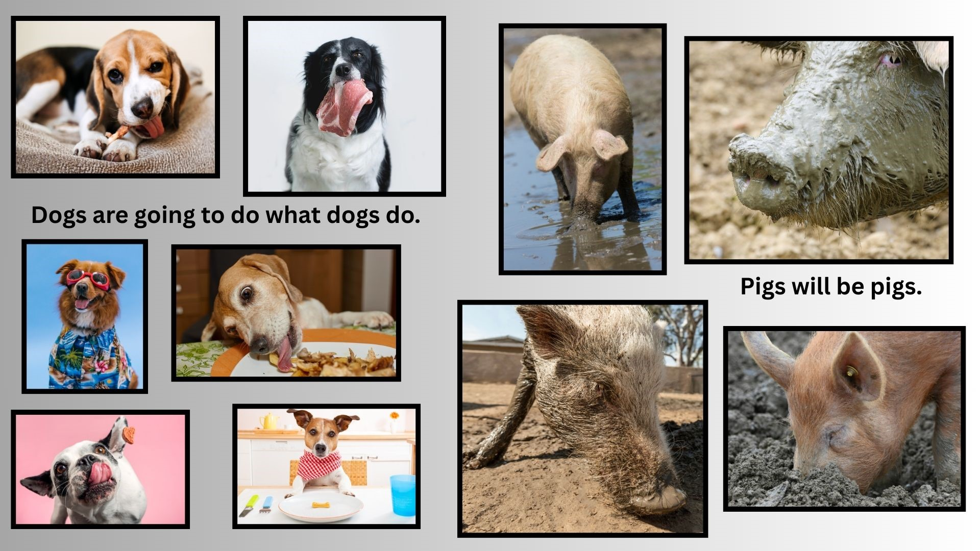
SESSION 8 Distractions & Deceit In A Strange Land
Traveler Beware – 2 Peter 2:21-22
²² What the true
proverb says has
happened to them:
"The dog returns to
its own vomit,
and the sow, after
washing herself,
returns to wallow
in the mire."
Notes:
²² What the true proverb says has happened to them: "The dog returns to its own vomit, and the sow, after washing herself, returns to wallow in the mire.“
That is the nature of the dog and the sow – they can’t change it.
The old must become new.
Our nature must be changed and transformed.
2 Corinthians 5:17 - Therefore, if anyone is in Christ, he is a new creation. The old has passed away; behold the new has come.
Romans 12:2 ESV - Do not be conformed to this world, but be transformed by the renewal of your mind, that by testing you may discern what is the will of God, what is good and acceptable and perfect.
2 Corinthians 3:18 ESV - And we all, with unveiled face, beholding the glory of the Lord, are being transformed into the same image from one degree of glory to another. For this comes from the Lord who is the Spirit.

Slide 14
SESSION 8 Distractions & Deceit In A Strange Land
The Perfect Stranger
2 Peter 1:3-4 “His divine power has granted to us all things that pertain to life and godliness, through the knowledge of Him who called us to His own glory and excellence, ⁴ by which He has granted to us his precious and very great promises, so that through them you may become partakers of the divine nature, having escaped from the corruption that is in the world because of sinful desire.
JESUS provides ALL we need to live godly lives.
“Whoever says ‘I know Him’ but does not keep His commandments is a liar, and the truth is not in him. “1 John 2:4 ESV
“Beloved, do not believe every spirit, but test the spirits to see whether they are from God, for many false prophets have gone out into the world.” 1 John 4:1 ESV
“Little children, you are from God and have overcome them,
for He who is in you is greater than he who is in the world.”
1 John 4:4 ESV
Notes:
1 John 3:4 ESV - Everyone who makes a practice of sinning also practices lawlessness; sin is lawlessness.
1 John 3:6 ESV - No one who abides in him keeps on sinning; no one who keeps on sinning has either seen him or known him.
1 John 3:7 ESV - Little children, let no one deceive you. Whoever practices righteousness is righteous, as he is righteous.
1 John 3:8 ESV - Whoever makes a practice of sinning is of the devil, for the devil has been sinning from the beginning. The reason the Son of God appeared was to destroy the works of the devil.
1 John 3:9 ESV - No one born of God makes a practice of sinning, for God's seed abides in him; and he cannot keep on sinning, because he has been born of God.
1 John 3:10 ESV - By this it is evident who are the children of God, and who are the children of the devil: whoever does not practice righteousness is not of God, nor is the one who does not love his brother.
1 john 2:4 1 John 2:3 ESV - And by this we know that we have come to know him, if we keep his commandments.
1 John 2:4 ESV - Whoever says "I know him" but does not keep his commandments is a liar, and the truth is not in him,
1 John 2:5 ESV - but whoever keeps his word, in him truly the love of God is perfected. By this we may know that we are in him:
1 John 2:6 ESV - whoever says he abides in him ought to walk in the same way in which he walked.
1 John 4:1 ESV - Beloved, do not believe every spirit, but test the spirits to see whether they are from God, for many false prophets have gone out into the world.
1 John 4:2 ESV - By this you know the Spirit of God: every spirit that confesses that Jesus Christ has come in the flesh is from God,
1 John 4:3 ESV - and every spirit that does not confess Jesus is not from God. This is the spirit of the antichrist, which you heard was coming and now is in the world already.
1 John 4:4 ESV - Little children, you are from God and have overcome them, for he who is in you is greater than he who is in the world.
1 John 4:5 ESV - They are from the world; therefore they speak from the world, and the world listens to them.
1 John 4:6 ESV - We are from God. Whoever knows God listens to us; whoever is not from God does not listen to us. By this we know the Spirit of truth and the spirit of error.
1 john 5:18 1 John 5:18 ESV - We know that everyone who has been born of God does not keep on sinning, but he who was born of God protects him, and the evil one does not touch him.
1 John 5:19 ESV - We know that we are from God, and the whole world lies in the power of the evil one.
1 John 5:20 ESV - And we know that the Son of God has come and has given us understanding, so that we may know him who is true; and we are in him who is true, in his Son Jesus Christ. He is the true God and eternal life.
1 John 5:21 ESV - Little children, keep yourselves from idols.

Slide 15

SESSION 8 Distractions & Deceit In A Strange Land

