Slide 1
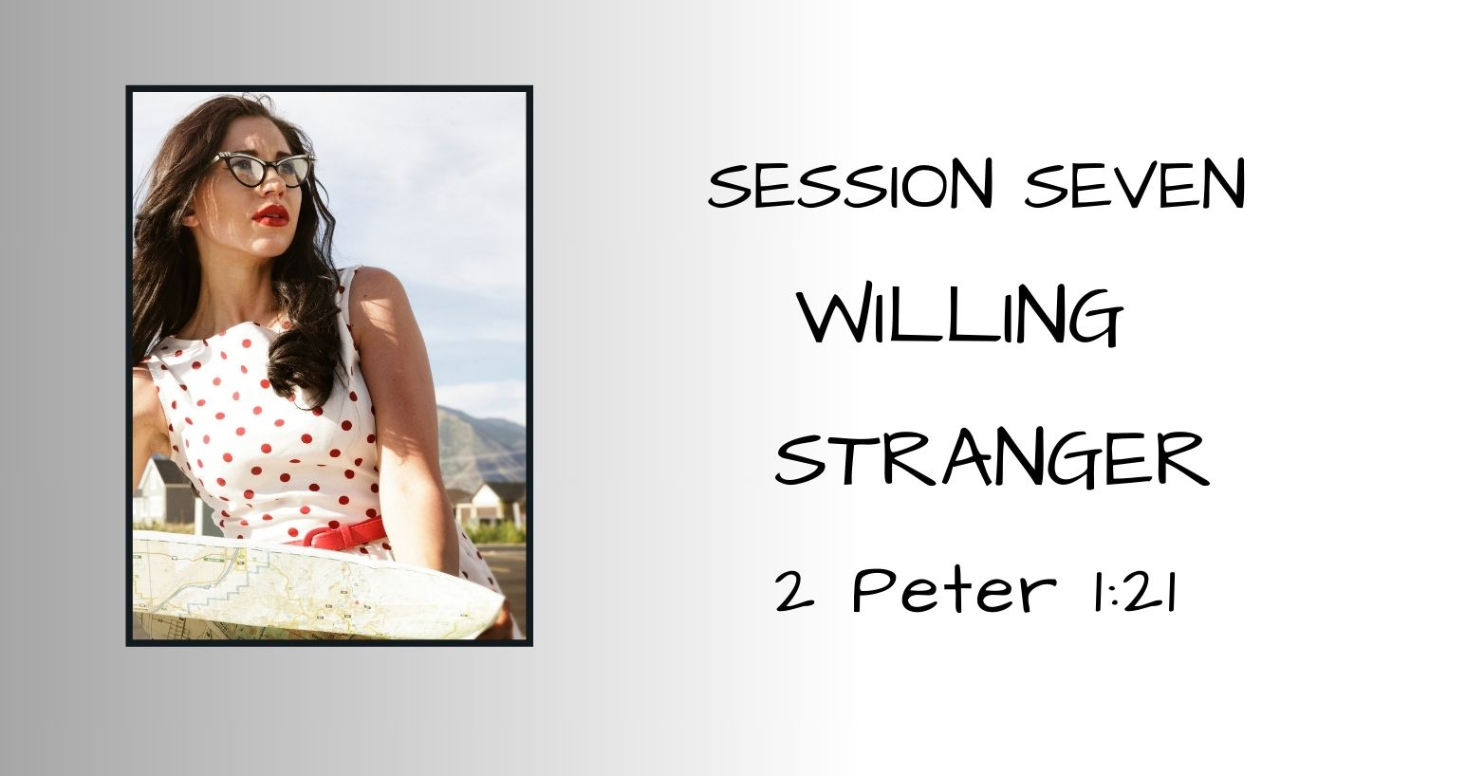
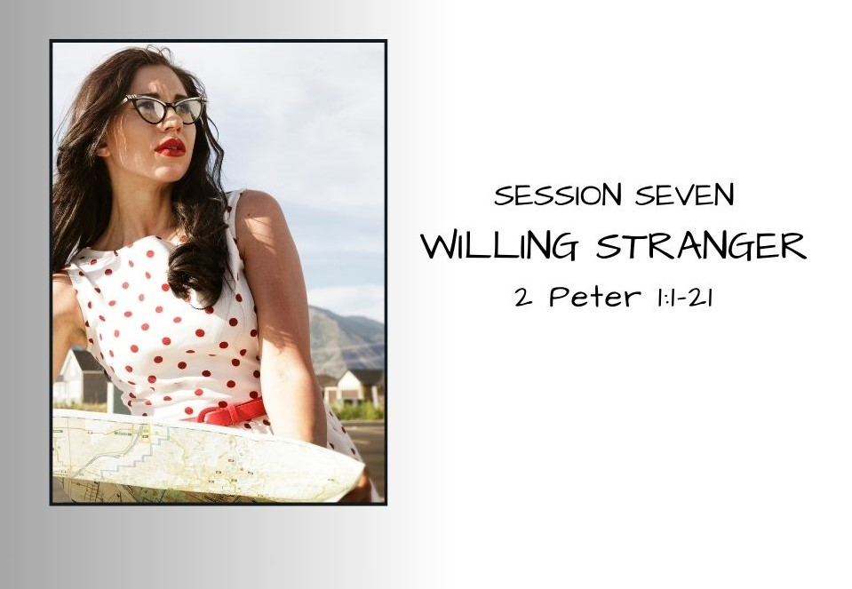

Slide 2
SESSION 7 – Willing Stranger
Session 6 Recap – Leading In A Strange Land
Deborah: The Rally Cry
  Deborah – a stranger living among God’s chosen but hard-hearted, hard-headed, & disobedient people
  Deborah – Prophet, Judge, Co-Commander of the Israeli Army o God’s people
  Willing, Obedient, Faithful, and Blessed. Israel had forty years of rest under Deborah’s leadership.
First Peter Summary
  CH. 1 – You are Strangers living in a strange land – CHOSEN and called to HOLINESS
  CH. 2 – You have a NEW IDENTITY and a NEW ALLEGIANCE
  CH. 3 – Honor God in ALL AREAS of LIFE – Always ready to testify of the HOPE you have in Jesus
  CH. 4 – You have a NEW way of THINKING, a NEW FOCUS, and
    you’re readying yourself in the Spirit for the TRIALS that will come
  CH. 5 – Humble, Watchful, and Prepared to be shepherded and to
    Shepherd well

Slide 3
SESSION 7 – Willing Stranger
Prelude: Rebekah’s Story – Packing for the Journey
Life Interrupted
  Unexpected proposals
  Life-changing decisions
  Faith-filled confidence
  Confident preparation for an unknown future
  An interruption may be a divine invitation to participate in God’s work.
  Rebekah was God’s answer to Abraham’s servant’s prayer –
  You may be God’s answer to
  someone else’s prayer.
Notes:
Eliezer is possibly the trusted servant sent by Abraham to find a wife for Issac. Gen 15:2 – Abraham originally thought he would be his heir – servant in Rebekah’s story not identified by name (only oldest of his household who oversaw all that Abraham had) Eliezer (of Damascus) name meaning-”GOD IS HELP”
550 mile one-way trip from Haran to Negeb where Isaac lived – estimated 21 days by camel
CONFIDENCE IN THE UNKNOWN
Heb 4:16 - Let us then with confidence draw near to the throne of grace, that we may receive mercy and find grace to help in time of need.
Ephesians 3:12 ESV - in whom we have boldness and access with confidence through our faith in him.
Psalm 37:5 ESV - Commit your way to the LORD; trust in him, and he will act.
And Isaac went out to meditate in the field toward evening. And he lifted up his eyes and saw, and behold, there were camels coming. And Rebekah lifted up her eyes, and when she saw Isaac, she dismounted from the camel and said to the servant, "Who is that man, walking in the field to meet us?" The servant said, "It is my master." So she took her veil and covered herself. And the servant told Isaac all the things that he had done. Then Isaac brought her into the tent of Sarah his mother and took Rebekah, and she became his wife, and he loved her. So Isaac was comforted after his mother's death. - Genesis 24:63-67 ESV

Slide 4
SESSION 7 – Willing Stranger
Introduction to 2 Peter – Strange Landscape
AUTHOR. The Apostle Peter
AUDIENCE. Gentile and Jewish believers in Pontus, Galatia, Cappadocia, western Asian Minor, and Bithynia – all part of the Roman Empire. (Modern-day Turkey.)
SETTING.
Approximately 64-67 A.D. shortly before Peter’s execution
The culture was hostile towards Christians and about to get worse
Nero was the ruler of the Roman Empire (A.D. 54-68)
THEME. Grace transforms, equips, and empowers the Believer
Notes:
Audience. Believed to be addressed to the same group as 1st Peter because he says, "This is now the second letter I am writing to you, beloved."
Timeframe. Approximately 64-67 A.D., shortly before Peter's execution – no exact timing between 64-67 A.D.
Commonly accepted Church tradition says that Peter was crucified upside-down (because he was unworthy to be crucified in the same manner as Christ in Rome fulfilling Jesus prophecy in
John 21:18 - Truly, truly, I say to you, when you were young, you used to dress yourself and walk wherever you wanted, but when you are old, you will stretch out your hands, and another will dress you and carry you where you do not want to go." (This he said to show by what kind of death he was to glorify God.) And after saying this he said to him, "Follow me." - John 21:18-19 ESV
Nero was Emperor of the Roman Empire from 54 A.D. (17 years old) to– to 59 A.D. he was described as a reasonable ruler although morally corrupt, beginning in 59 A.D., Nero became more irrational and more outspoken against the Christians – persecutions worsened. In 64 A.D. the Great Fire in Rome destroyed 75% of the city. Nero blamed the Christians.
In 68 A.D. Nero at the peak of his insanity, irrational behavior, worsening taxation, unfair rule, and persecution of the Christians, Rome revolted. Nero fled and eventually committed suicide.
During this period (between 64-68 A.D.) Peter was imprisoned and eventually executed.
Theme. Grace transforms, equips, and empowers Christians
(Matt 16:16-20 Peter –disciples-Jesus on this rock...differing views: Jesus tells this to Peter empowering him for Acts 2 and the power-filled message he will deliver in his first time message as the church is being established – the empowering then extends to all; Jesus is actually referring to Himself – because HE is the foundation of the church and the church BELONGS to HIM – Ephesians 5:23-25 – Christ is the head of the church; Colossians 1:18 – HE is the head of the body, the church –referring to Christ

Slide 5
SESSION 7 – Willing Stranger
Greetings Strangers – 2 Peter 1:1-2
"¹ Simeon Peter, a servant and apostle of Jesus Christ, To those who have obtained a faith of equal standing with ours by the righteousness of our God and Savior Jesus Christ: ² May grace and peace be multiplied to you in the knowledge of God and of Jesus our Lord.”
Simeon or Simon (hearing/listening)
Jewish given name – the name of the fisherman
Peter (rock)
Greek name given by Jesus –
the name of the Apostle of Christ
EQUAL STANDING:
From Who you WERE to Who you ARE NOW in Christ Jesus
Notes:
V. 1 "¹ Simeon Peter, Simeon or Simon meaning "hearing" or "listening" – his Jewish given name-fisherman name – Peter is the Greek name given to him by Jesus as an Apostle which means "rock" Mat.16:18, perhaps he used both names to remind his readers of the significant change of identity that took place when he became a Christ-follower: from Jewish fisherman to Christian apostle of Christ.
a servant and apostle of Jesus Christ,
In 1 Peter v. 1, Peter's greeting was subdued and humble. In 2 Peter, the use of his Jewish and Greek names and titles of Servant and Apostle of Jesus Christ seem to more clearly emphasize his transformation in Christ (from fisherman to apostle of Jesus) and his responsibility and authority to write the message of 2 Peter - the last letter he will write. Servanthood is emphasized or Apostle.
To those who have obtained a faith of equal standing (equally precious, equally honored, of equal value) with ours by the righteousness of our God and Savior Jesus Christ:
Perhaps, one reason he wrote his greeting as he did was to reinforce the message that in Jesus Christ,
We are all transformed – the old has become new, we are ALL new creations in Christ Jesus
We are all to be servants of Christ – obedient to whatever our calling
all Christ-followers have a "faith of equal standing" because of the righteousness of Jesus. One believer's salvation is not better than another believer's. Our obedience, willingness to serve, and cooperation with the Holy Spirit's sanctifying work in us may vary greatly, but our salvation stands equal.
V.2 May grace and peace be multiplied to you in the knowledge of God and of Jesus our Lord. (Once again Peter says, "may grace and peace be multiplied to you" used in 1 Peter)
Grace – God for us. Charis – that which gives joy, pleasure, delight, sweetness, charm, loveliness, goodwill, loving-kindness, favor.
Peace – a state of national tranquility, exemption from rage and havoc of war. Peace between individuals – harmony. Security, safety, prosperity. The tranquil state of a soul assured of its salvation through Christ, and so fearing nothing
Grace and peace – finding joy and delight, security and safety in a world ruled by an increasingly insane emperor was becoming more and more difficult
"IN THE KNOWLEDGE OF GOD AND OF JESUS OUR LORD." It is IN knowing God and Jesus that we have Grace and Peace – God is the source of both! The better we know God, the easier it becomes to trust Him and find grace and peace. The deeper our head and heart knowledge of God, the more discerning we become between truth and falsehood – the less likely we are to be fooled by false teachers, a subject Peter addresses in chapter two.

Slide 6
SESSION 7 – Willing Stranger
Packed, Poised, and Positioned – 2 Peter 1:3-4
³His divine power has granted to us all things that pertain to life and godliness, through the knowledge of him who called us to his own glory and excellence, ⁴ by which he has granted to us his precious and very great promises, so that through them you may become partakers of the divine nature, having escaped from the corruption that is in the world because of sinful desire.
HE knows what we need for our sojourn in this strange land.
HE provides ALL THINGS needed
WHEN it is needed!
Our responsibility –
KNOW HIM
TRUST HIS PROMISES
Notes:
V.3 His divine power has granted to us all things that pertain to life and godliness, through the knowledge of Him who called us to His own glory and excellence,
2 Peter 1:3 NIV "His divine power has given us everything we need for a godly life through our knowledge of Him who called by His own glory and goodness."
His divine [(GOD-like, of God, from God) Merriam-Webster – of, relating to, or proceeding directly from God] power has granted (to present, bestow, given) to us ALL (everything, every, all manner of, whatsoever, whosoever, the whole enchilada!, ALL) things that pertain (is related to, for, with, by the side of, near to) to life and godliness, through the
knowledge of Him who called (to call aloud, invite, call by name, specific invitation) us to His own glory and excellence
KNOWLEDGE – g1922 (epignōsis a-pig-nŏ-sis) precise, complete, and correct knowledge – in the N.T. = knowledge of things ethical, divine, and absolute; knowledge, recognition, full discernment
1 Tim 2:4 ESV (God) who desires all people to be saved and to come to the knowledge of the truth.
Col 1:10 ESV - So as to walk in a manner worthy of the Lord, fully pleasing to him: bearing fruit in every good work and increasing in the knowledge of God; - Colossians 1:10 ESV
Phil 1:9 ESV And it is my prayer that your love may abound more and more, with knowledge and all discernment
Col 3:10 ESV and have put on the new self, which is being renewed in knowledge after the image of its creator.
V. 4 ⁴ by which (based on “His Glory and Excellence” vs. 3) He has granted to us His precious and very great promises, exceedingly great and extremely valuable – inviolate promises – protected (by God Himself), His promises are secure, sacred, untouchable, holy
so that through them you may become partakers (sharer, partner in, fellowship, companion) of the divine nature, having escaped from the corruption that is in the world because of sinful desire.
Hebrews 13:210-21 "Now may the God of peace who brought again from the dead our Lord Jesus, the great shepherd of the sheep, by the blood of the eternal covenant, equip you with everything good that you may do His will, working in us that which is pleasing in His sight, through Jesus Christ, to whom be glory forever and ever. Amen. - Hebrews 13:20-21 ESV
"having escaped (escape, flee from, get away from, out of the trap) from the corruption that is in the world because of sinful desire."
We have escaped from the bondage of sin. We are no longer captives of the sin nature. We are in the process of sanctification.
1 Peter 2-put off the old man – put away malice, deceit, hypocrisy, envy, slander

Slide 7
SESSION 7 – Willing Stranger
Packed, Poised, and Positioned – 2 Peter 1:5-9
⁵ For this very reason, make every effort to supplement your faith with virtue, and virtue with knowledge, ⁶ and knowledge with self-control, and self-control with steadfastness, and steadfastness with godliness, ⁷ and godliness with brotherly affection, and brotherly affection with love.
⁸ For if these qualities are yours and are increasing, they keep you from being ineffective or unfruitful in the knowledge of our Lord Jesus Christ. ⁹ For whoever lacks these qualities is so nearsighted that he is blind, having forgotten that he was cleansed from his former sins.
Notes:
V5-7 - For this very reason, [BECAUSE we have escaped the bondage of sin-we’ve taken off-set aside-the old we must put on the new!] make every effort to supplement [add to, continue to build, grow] your faith with virtue, and virtue with knowledge, ⁶ and knowledge with self-control, and self-control with steadfastness, and steadfastness with godliness, ⁷ and godliness with brotherly affection, and brotherly affection with love.
Make every effort to supplement your faith with these virtues of the heart – not actions to do, but attitudes that :
Faith, Virtue (moral excellence), Knowledge, Self-control, Steadfastness, Godliness, Brotherly (Phileo) affection, Love (agape – deep, abiding love, reverential)
FROM in 1 PETER 2:1 -Peter is writing to believers. PUT OFF –Get Rid of the Characteristics and Behaviors of the Old Man
Malice – malignity, maliciousness, ill-will, desire to injure, wickedness, depravity, evil, trouble
Deceit – crafty, wily, guile, deception, tricking-convincing someone to accept lies as truth
Hypocrisy – feigning (pretending to be) something or someone that you are not, two-faced, giving a false impression, - acting of a stage player
Envy – jealously (Mat 27:18, Mark 15:10 – the chief priests and religious elites acted in envy to get rid of Jesus
Slander – defamation, evil speaking, backbiting
V.8 ⁸ For if these qualities are yours and are increasing (continuing to grow!), they keep you from being ineffective (not productive in service) or unfruitful (developing the fruits of the Spirit)in the knowledge of our Lord Jesus Christ. Your effectiveness will continue to increase as well. ⁹ For whoever lacks these qualities is so nearsighted that he is blind, having forgotten that he was cleansed from his former sins. When these qualities are not present it’s as though you’ve forgotten that you were saved.

Slide 8
SESSION 7 – Willing Stranger
2 Peter 1:5-9 – QUESTION 4 (page 75)
BROTHERLY
AFFECTION
LOVE
GODLINESS
Peter’s Faith Supplements
STEADFASTNESS
SELF-CONTROL
KNOWLEDGE
VIRTUE
e
FAITH
LOVE
GOODNESS
PATIENCE
JOY
PEACE
FAITHFULNESS
Paul’s Fruit of the Spirit
SELF-CONTROL
FAITHFULNESS
KINDNESS
GENTLENESS
Notes:
Galatians 5:22-26 ESV – "But the fruit of the Spirit is love, joy, peace, patience, kindness, goodness faithfulness, gentleness, self-control; against such things there is no law. And those who belong to Christ Jesus have crucified the flesh with its passions and desires. If we live by the Spirit, let us also keep in step with the Spirit. Let us not become conceited, provoking one another, envying one another."
John 15:8 ESV By this my Father is glorified, that you bear much fruit and so prove to be my disciples. - John 15:8 ESV
Matt 7:16-20 You will recognize them by their fruits. Are grapes gathered from thornbushes, or figs from thistles? So, every healthy tree bears good fruit, but the diseased tree bears bad fruit. A healthy tree cannot bear bad fruit, nor can a diseased tree bear good fruit. -Every tree that does not bear good fruit is cut down and thrown into the fire. -Thus you will recognize them by their fruits
John 15:4-5 ESV Abide in me, and I in you. As the branch cannot bear fruit by itself, unless it abides in the vine, neither can you, unless you abide in me. I am the vine; you are the branches. Whoever abides in me and I in him, he it is that bears much fruit, for apart from me you can do nothing.
By this my Father is glorified, that you bear much fruit and so prove to be my disciples. - John 15:8 ESV
You did not choose me, but I chose you and appointed you that you should go and bear fruit and that your fruit should abide, so that whatever you ask the Father in my name, he may give it to you. - John 15:16 ESV
But what fruit were you getting at that time from the things of which you are now ashamed? For the end of those things is death. - Romans 6:21 ESV
But now that you have been set free from sin and have become slaves of God, the fruit you get leads to sanctification and its end, eternal life. - Romans 6:22 ESV
Likewise, my brothers, you also have died to the law through the body of Christ, so that you may belong to another, to him who has been raised from the dead, in order that we may bear fruit for God. - Romans 7:4 ESV
For while we were living in the flesh, our sinful passions, aroused by the law, were at work in our members to bear fruit for death. - Romans 7:5 ESV
But the fruit of the Spirit is love, joy, peace, patience, kindness, goodness, faithfulness, - Galatians 5:22 ESV
(for the fruit of light is found in all that is good and right and true), - Ephesians 5:9 ESV
filled with the fruit of righteousness that comes through Jesus Christ, to the glory and praise of God. - Philippians 1:11 ESV
which has come to you, as indeed in the whole world it is bearing fruit and increasing--as it also does among you, since the day you heard it and understood the grace of God in truth, - Colossians 1:6 ESV
so as to walk in a manner worthy of the Lord, fully pleasing to him: bearing fruit in every good work and increasing in the knowledge of God; - Colossians 1:10 ESV
For the moment all discipline seems painful rather than pleasant, but later it yields the peaceful fruit of righteousness to those who have been trained by it. - Hebrews 12:11 ESV
Through him then let us continually offer up a sacrifice of praise to God, that is, the fruit of lips that acknowledge his name. - Hebrews 13:15 ESV

Slide 9
SESSION 7 – Willing Stranger
Packed, Poised, and Positioned – 2 Peter 1:10-12
¹⁰ Therefore, brothers, be all the more diligent to confirm your calling and election, for if you practice these qualities you will never fall. ¹¹ For in this way there will be richly provided for you an entrance into the eternal kingdom of our Lord and Savior Jesus Christ. ¹² Therefore I intend always to remind you of these qualities, though you know them and are established in the truth that you have.
    THEREFORE
    Be diligent
    Confirm your calling and election
    Practice, practice, practice
    THEREFORE
    I will continue to remind you!
Notes:
V. 10 ¹⁰ Therefore (because you don’t want to be ineffective or unfruitful or lacking in qualites – or appearing like don’t remember the commitment you made), brothers, be all the more diligent to confirm your calling and election (know with certainty that you have been chosen, elected, called to serve), for if you practice (regularly exercising the qualities listed above) these qualities you will never fall.(you will remain steadfast – not faltering in the way)
V.11 ¹¹ For in this way there will be richly provided for you an entrance into the eternal kingdom of our Lord and Savior Jesus Christ.
V.12 ¹² Therefore (because this is so critically important)I intend always to remind you of these qualities, though you know them and are established (rooted, grounded, unshakeable) in the truth that you have.

Slide 10
SESSION 7 – Willing Stranger
Packed, Poised, and Positioned – 2 Peter 1:13-15
¹³ I think it right, as long as I am in this body, to stir you up by way of reminder, ¹⁴ since I know that the putting off of my body will be soon, as our Lord Jesus Christ made clear to me. ¹⁵ And I will make every effort so that after my departure you may be able at any time to recall these things.”
WAKE UP!
NEVER FORGET!
Notes:
¹³ I think it right, as long as I am in this body, to stir you up by way of reminder,(this is so important, I will continue to remind you and stir up [wake up, awaken arouse – ex. awaken the sleeper, a stormy sea agitated, waves rising or stir up the mind-make you think – agitated
¹⁴ since I know that the putting off of my body will be soon, as our Lord Jesus Christ made clear to me (The LORD has made it clear that my death is nearing.)
¹⁵ And I will make every effort so that after my departure you may be able at any time to recall these things (I will do everything I can to help you remember these critical truths because you’re going to need them to flourish in your walk with Christ and through the end of your days.) REMEMBER!!!

Slide 11
SESSION 7 – Willing Stranger
The Perfect Stranger – 2 Peter 1:16-18
¹⁶ For we did not follow cleverly devised myths when we made known to you the power and coming of our Lord Jesus Christ, but we were eyewitnesses of his majesty. ¹⁷ For when he received honor and glory from God the Father, and the voice was borne to him by the Majestic Glory, "This is my beloved Son, with whom I am well pleased," ¹⁸ we ourselves heard this very voice borne from heaven, for we were with him on the holy mountain.
WE WERE ON THE MOUNTAIN!
EYEWITNESSES TO HIS POWER, GLORY, AND MAJESTY
WE HEARD THE VOICE OF GOD
Notes:
¹⁶ For we did not follow cleverly devised myths when we made known to you the power and coming of our Lord Jesus Christ (we have never made up stories or told you fantasies – we have seen with our own eyes the truth of Jesus Christ that we have shared with you – we have given you the actual words that He said during His ministry on earth – we saw it all with our own eyes!!!), but we were eyewitnesses of his majesty. ¹⁷ For when he received honor and glory from God the Father, and the voice was borne to him by the Majestic Glory, "This is my beloved Son, with whom I am well pleased," ¹⁸ we ourselves heard this very voice borne from heaven, for we were with him on the holy mountain. (We heard God speak on the Mount of Transfiguration – church tradition says Mount Tabor – scholars favor Mount Hermon-Mat 17:1-8, Mark 9:2-8, Luke 9:28-36,
Peter is laying the groundwork for what we’ll find in chapter two – the false teachers. He wants the churches reading both of his letters to understand that he is speaking from a position of authority – first-hand witness to the truth of God’s promised Messiah – His Son sent to earth – Jesus Christ
They MUST know the truth in order to recognize the lies – the same is as true today as it was then – if anything lies have become more pervasive - more subtle – more culturized – more pernicious – love that word – it means having a highly injurious or destructive effect – it’s deadly, but in a subtle, sinister, insidious sort of way

Slide 12
SESSION 7 – Willing Stranger
The Perfect Stranger – 2 Peter 1:19-21
¹⁹ And we have the prophetic word more fully confirmed, to which you will do well to pay attention as to a lamp shining in a dark place, until the day dawns and the morning star rises in your hearts, ²⁰ knowing this first of all, that no prophecy of Scripture comes from someone's own interpretation. ²¹ For no prophecy was ever produced by the will of man, but men spoke from God as they were carried along by the Holy Spirit.“
  PROPHECY CONFIRMED
  THE LIGHT HAS COME
  WORDS SPOKEN BY MAN INSPIRED BY THE HOLY SPIRIT
Notes:
¹⁹ And we have the prophetic word (prophesies of the coming Messiah – opening the kingdom to all nations ROM 16:26) more fully confirmed (G949 bebaios – sure, firm, of force, more sure, steadfast), to which you will do well to pay attention (consider the prophets of the Old Testatment – over and over...but you would not listen – just as Israel was unwilling to listen and act in obedience, today’s unsaved “stop their ears” 2 Tim 4:3- itching ears listening only to teachers who pander to their passions; )
Acts 28:27 ESV For this people's heart has grown dull, and with their ears they can barely hear, and their eyes they have closed; lest they should see with their eyes and hear with their ears and understand with their heart and turn, and I would heal them.
Rom 11:8 ESV as it is written, "God gave them a spirit of stupor, eyes that would not see and ears that would not hear, down to this very day."
Matthew 11:15 ESVHe who has ears to hear, let him hear.
Ezekiel 12:2 ESV"Son of man, you dwell in the midst of a rebellious house, who have eyes to see, but see not, who have ears to hear, but hear not, for they are a rebellious house. -
Jeremiah 25:4 ESV You have neither listened nor inclined your ears to hear, although the LORD persistently sent to you all his servants the prophets, -
Jeremiah 5:21 ESV "Hear this, O foolish and senseless people, who have eyes, but see not, who have ears, but hear not.
Isaiah 42:20 ESV He sees many things, but does not observe them; his ears are open, but he does not hear.
as to a lamp shining in a dark place, until the day dawns and the morning star rises in your hearts, How often do you suppose Peter spent the entire night sitting in his boat fishing in the dark waters of the Sea of Galilee – what a sight it must have been when the morning star began to shine and dawn began to break – it was enough to make a fisherman wax poetic!
Peter knew that we are to be a light in the darkness –
²⁰ knowing this first of all, that no prophecy of Scripture comes from someone's own interpretation. ²¹ For no prophecy was ever produced by the will of man, but men spoke from God as they were carried along by the Holy Spirit."
the people dwelling in darkness have seen a great light, and for those dwelling in the region and shadow of death, on them a light has dawned." - Matthew 4:16 ESV
"You are the light of the world. A city set on a hill cannot be hidden. Nor do people light a lamp and put it under a basket, but on a stand, and it gives light to all in the house. In the same way, let your light shine before others, so that they may see your good works and give glory to your Father who is in heaven. - Matthew 5:14-16 ESV
to give light to those who sit in darkness and in the shadow of death, to guide our feet into the way of peace." - Luke 1:79 ESV

Slide 13
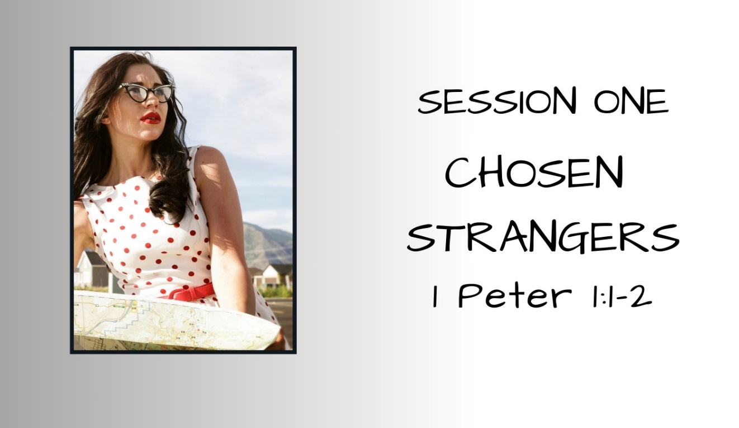
Strangers in a Strange Land Key Verse:
"You are a chosen race, a royal priesthood, a holy nation, a people for His own possession, that you may proclaim the excellencies of Him who called you out of darkness into His marvelous light. Once you were not a people, but now you are God's people; once you had not received mercy, but now you have received mercy.“ 1 Peter 2:9-10
  2 Peter Chapter 1 – Remember:
  Your identity in Christ Jesus
  God equips you for your calling
  You have a living hope and eternal promise
    confirmed by eyewitnesses to the TRUTH
  You are to exercise & grow your faith & its fruits
  You are to be the light in the darkness
Notes:
Key verse for our entire series. This is who you are – this is your country. YOU are God’s people. This is where you belong.

Slide 14
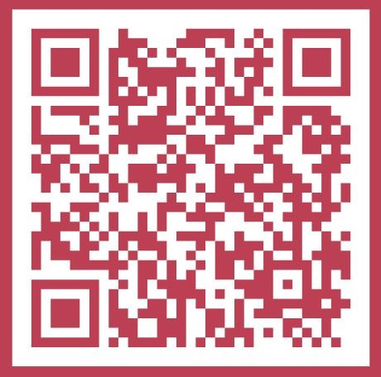
Read a “Love Letter #4” –
The Story of Peter’s conversation with Jesus during a walk along the shore of the Sea of Galilee.
                https://living-earswideopen.com/2025/02/25/love-letter-4/
Notes:
Key verse for our entire series. This is who you are – this is your country. YOU are God’s people. This is where you belong.

Slide 15
