Slide 1
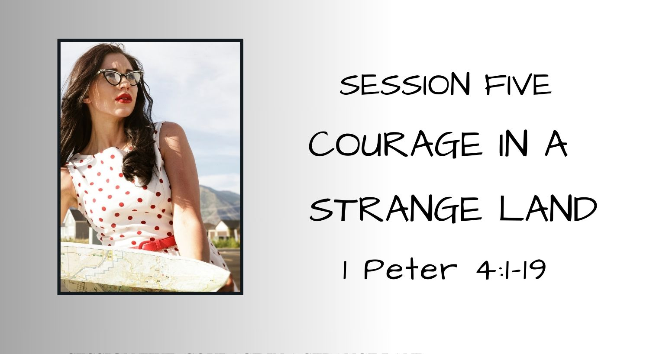

Slide 2
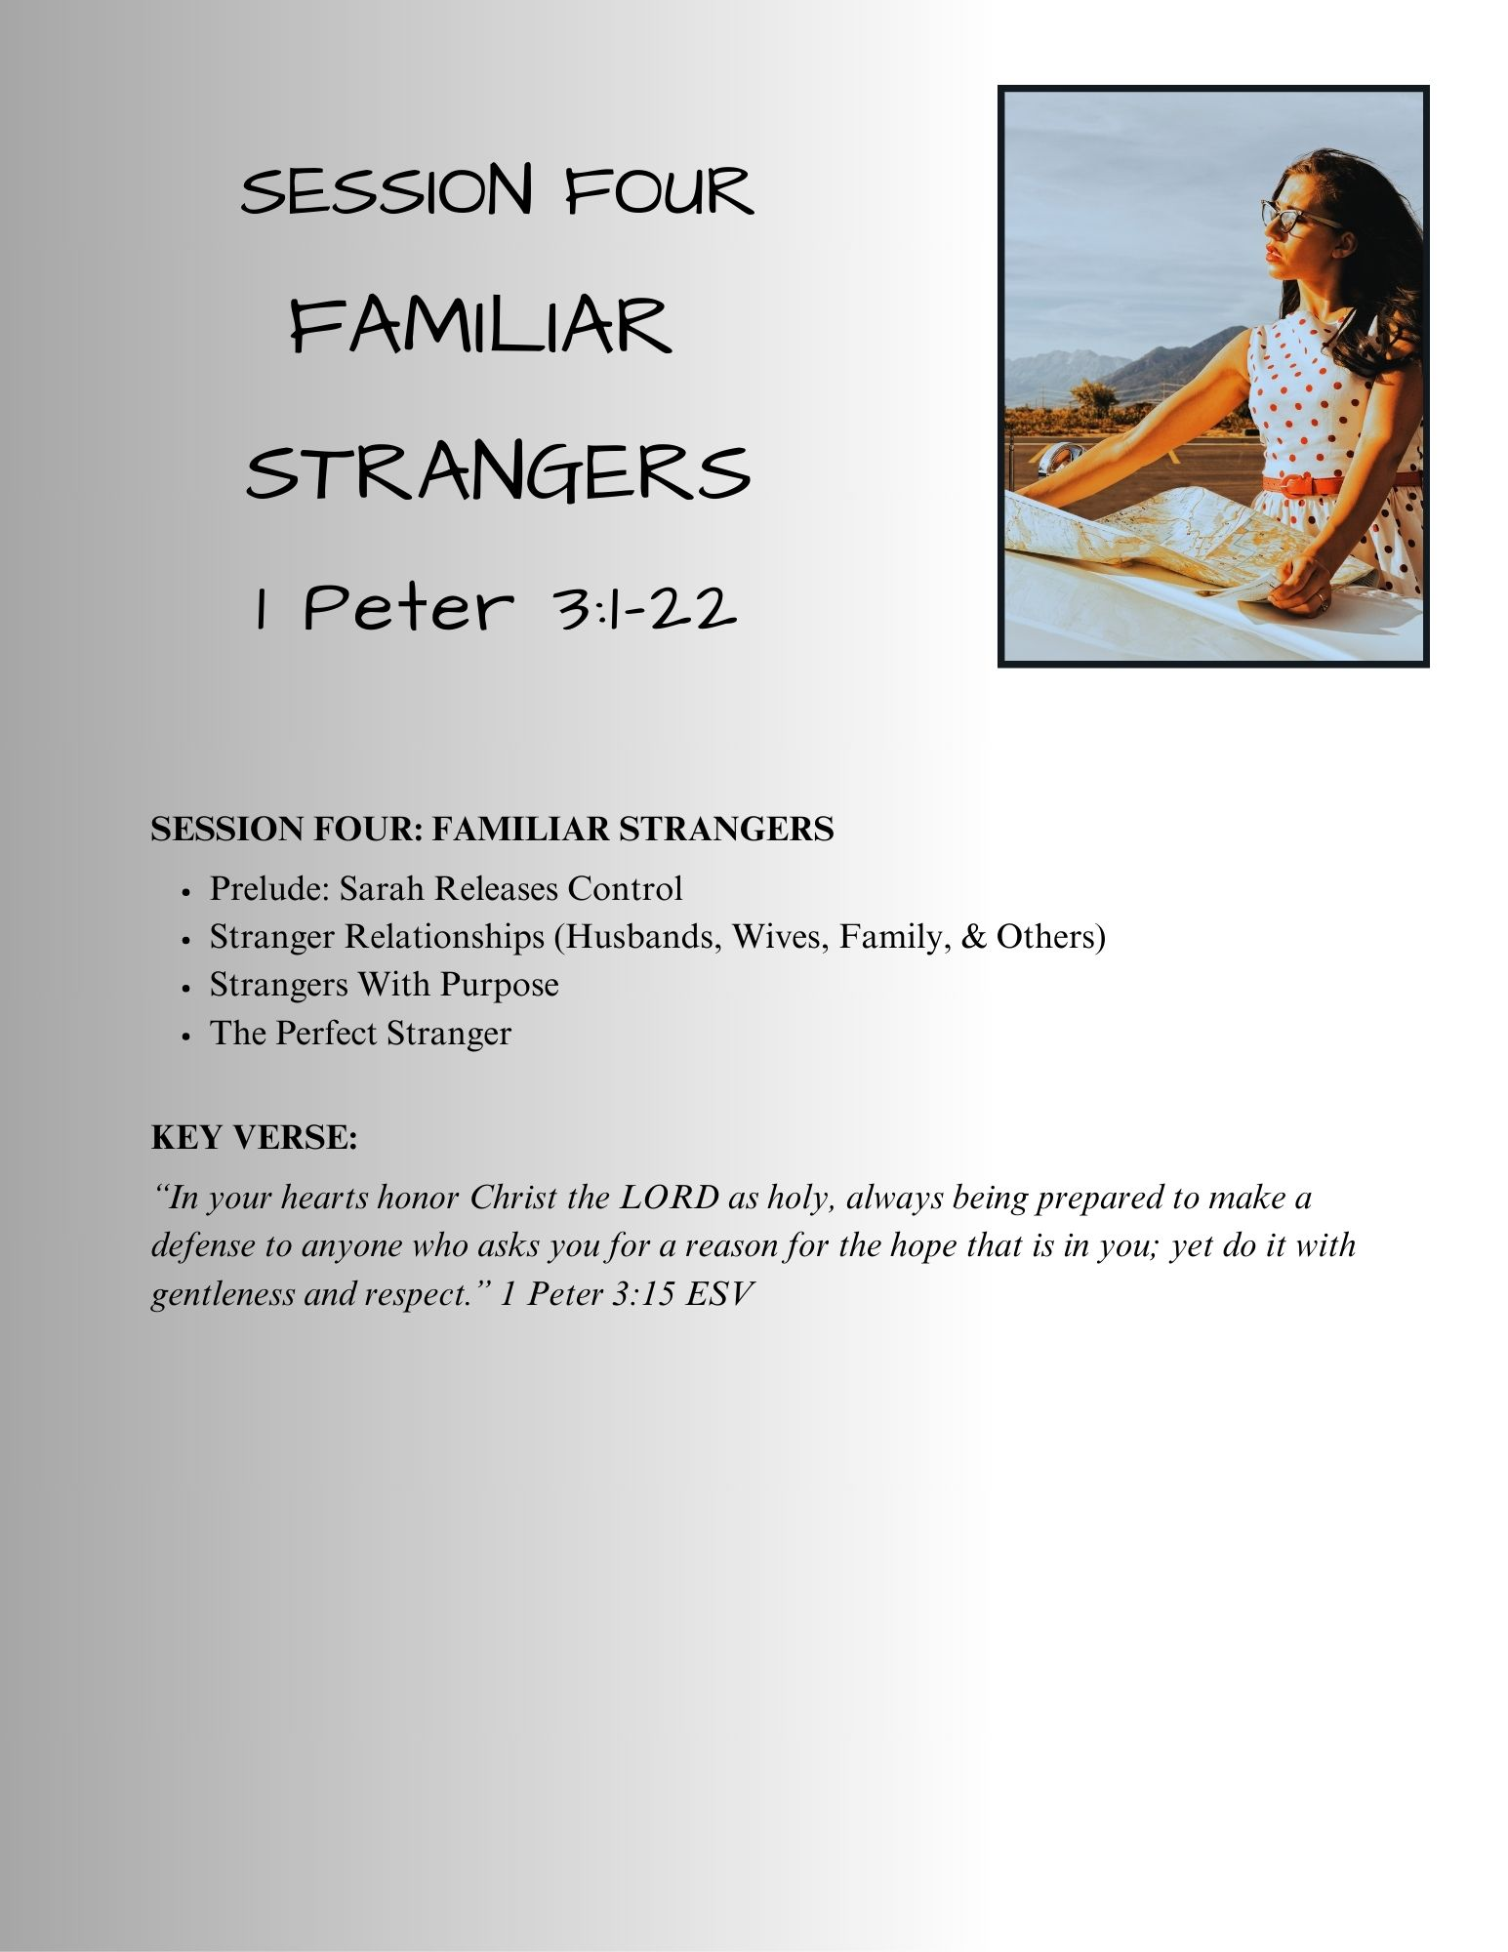
SESSION FIVE – Familiar Strangers
Session 4 – Familiar Strangers RECAP
Sarah: Releasing Control
  It’s impossible to be the person (wife, parent, daughter) God wants you to be if you are trying to make it on second-hand faith
First Peter Chapter Three
  The wife-husband relationship: love, honor, respect one another & your God-given role
  In all relationships, show Sympathy, Love, a Tender Heart & a Humble Spirit
  Counter-culture behavior doesn’t seek revenge, blesses others, is honest & truthful, flees evil, and seeks peace
  There is blessing and honor in the trials & tribulations suffered by the righteous
  Always be ready to give a defense for your faith
The Perfect Stranger
  Jesus is our Ark of Salvation
  The flood waters are a picture of baptism – it does not save us, but it
  portrays the cleansing we experience in Christ Jesus
Notes:
Sarah:
A second-hand relationship isn’t enough
A submissive exterior can hide a self-serving, controlling interior
Second-guessing God and His perfect timing has consequences
A surrendered heart and a direct relationship With God
The flood waters were the cleansing agent God used to wash away the wickedness of the world...but it was not the saving agent for Noah and his family – that was the ARK – the ARK symbolizes our Savior
The waters of Baptism symbolically wash away our sins BUT baptism isn’t the saving agent. Baptism is a picture of the cleansing we receive because Jesus redeemed and saved us through His death, burial, and resurrection.

Slide 3
SESSION FIVE – Courage In A Strange Land
Prelude: Rising to the Challenge – Esther’s Story
Living incognito
A desperate decision
The risky reveal
“And who knows whether you have not come
to the kingdom
for such a time as this?”
Esther: 4:14b
Notes:
True identity disguised behind a Persian name
Hadassah (myrtle – from myrtle tree, a symbol of peace, love, & prosperity – Esther (Persian name: star)
Haman, the Agagite – descendent of King Agag-king of the Amalekites, Israel’s enemy that was supposed to have been destroyed by Saul’s army – Saul’s disobedience led to this event – long-term consequences (1 Samuel 15:1-33)
(Exodus 17:8-16 Soon after Israel leaves Egypt, after the first “water from the rock” episode, the Amalekites attack the Jews in the wilderness – Moses- arms held by Aaron & Hur – Joshua leads army – defeats the Amalakites)
Reveal or try to hide her true identity??
As believers, it can be easy to be “incognito Christian” fitting into – not standing out – its safe, comfortable, and undemanding – requires no courage, risk-taking, rising to the challenge
It may be risky and there may be consequences
The message of Peter is that you cannot be an undercover believer-that is not our calling – it may seem safer – in the end its simply cowardly, and denies our faith – Peter knows about this first hand

Slide 4
SESSION FIVE – Courage In A Strange Land
A Stranger Way of Thinking – 1 Peter 4:1-2
¹ Since therefore Christ suffered in the flesh, arm yourselves with the same way of thinking, for whoever has suffered in the flesh has ceased from sin, ² so as to live for the rest of the time in the flesh no longer for human passions but for the will of God.
"It...means, has made a clear break with sin, has most definitely acted in a way which shows that obeying God, not avoiding hardship is the most important motivation for his or her action. ... Following through with the decision to obey God even when it will mean physical suffering has a morally strengthening effect on our lives it commits us more firmly than ever before to a pattern of action where obedience is even more important than our desire to avoid pain.“
Wayne Grudem, Tyndale New Testament Commentaries Vol. 17, IVP, Logos
Notes:
¹ Since therefore Christ suffered in the flesh Referring to 3:18 "For Christ also suffered once for sins, the righteous for the unrighteous, that He might bring us to God, being put to death in
the flesh but made alive in the spirit....,
arm (equip, take on) yourselves with the same way of thinking, [G1771-ennoia - the same thought, notion, concept, change of mindset and expanded understanding – Prov 3:21 "sound wisdom and discretion," Heb 4:12 – thinking, consideration, meditation, notion, concept]
Philippians 2:5-6 NKJV - Let this mind be in you which was also in Christ Jesus, who, being in the form of God, did not consider it robbery to be equal with God, but made Himself of no reputation, taking the form of a bondservant, [and] coming in the likeness of men. And being found in appearance as a man, He humbled Himself and became obedient to [the point of] death, even the death of the cross.
for whoever has suffered in the flesh has ceased (G3973-pauō: restrain, quit, desist, come to an end-cease, leave, refrain- NO LONGER STIRRED BY ITS INCITEMENTS AND SEDUCTIONS) from sin.
Doesn’t mean never sin again – not practicing a sinful lifestyle
1 Kings 8:46 ESV - "If they sin against you--for there is no one who does not sin
Proverbs 20:9 ESV - Who can say, "I have made my heart pure; I am clean from my sin"?
Ecclesiastes 7:20 ESV - Surely there is not a righteous man on earth who does good and never sins.
James 3:2 ESV - For we all stumble in many ways. And if anyone does not stumble in what he says, he is a perfect man, able also to bridle his whole body.
1 John 1:8 ESV - If we say we have no sin, we deceive ourselves, and the truth is not in us.
----------
² so as to live for the rest of the time in the flesh no longer for human passions but for the will of God. When we repent and surrender in faith to Jesus Christ as our Lord and Savior, the initial act of regeneration, the work of the Holy Spirit breathes new life into the walking dead, and pronounces us washed clean – freeing us from the bondage of sin. However, the ongoing sanctifying work of the Holy Spirit continues the transformation process and convicts, encourages, and equips us to turn loose of the sins we've chosen to cling to. The work of the Holy Spirit is to transform us into the image of Jesus.
Apostle Paul suffered repeatedly and still mourned that his flesh – the old man continued to rear its head – Romans 7:13-25
Are you willing to give up your sin – your precious passions?
Are you willing to suffer (be persecuted, ridiculed, scorned because you are no longer willing to participate in the sins of your past?

Slide 5
SESSION FIVE – Courage In A Strange Land
A Stranger Way of Thinking – 1 Peter 4:3-6
³ For the time that is past suffices for doing what the Gentiles want to do, living in sensuality, passions, drunkenness, orgies, drinking parties, and lawless idolatry. ⁴ With respect to this they are surprised when you do not join them in the same flood of debauchery, and they malign you; ⁵ but they will give account to him who is ready to judge the living and the dead. ⁶ For this is why the gospel was preached even to those who are dead, that though judged in the flesh the way people are, they might live in the spirit the way God does.
ENOUGH ALREADY!
The season of sin is over,
It’s done with,
No more!
Notes:
³ For the time that is past suffices for doing what the Gentiles (the unsaved) want to do (ENOUGH ALREADY! The season of sin is over, done with, no more!), living in sensuality, passions, drunkenness, orgies, drinking parties, and lawless idolatry. (sensual, reprobate, unbridled idolatry – beyond the limits of allowed by civil laws – truly abhorrent)
⁴ With respect to this they are surprised when you do not join them (G4936-syntrechō -literally means "run with them") in the same flood of debauchery (unrestrained immorality and dissipation), and they malign you (why won't you join us anymore, too spiritual? Too self-righteous? What's up with that?);
⁵ but they will give account (as reporting to a employer boss, reckoning, accounting for your activities-work done-
Matthew 12:36 “But I say unto you, that every idle word that men shall speak, they shall give account thereof in the day of judgment.” – also,
Matthew 18:23-servant giving an account to the king,
Luke 16:2-steward giving a report of how he has managed his employers accounts,
V.5 But they will give account to Him who is ready to judge the living and the dead. (the dead – all people; judgment is coming -Revelation 20:11-15)
God is seated on His throne – the earth and sky are no more
the dead, great & small stand before the throne, the books opened – all judged by what is written
Book of Life is opened- and all whose name is not
15 And if anyone's name was not found written in the book of life, he was thrown into the lake of fire." Revelation 20:11-15 ESV
⁶ For this is why the gospel was preached even to those who are dead, that though judged in the flesh the way people are, they might live in the spirit the way God does.
(Peter is referring to believers that are now dead- perhaps because of persecution, maybe not-it doesn't say – the gospel was preached to them so that they would escape the judgment and condemnation that is to come that is to come. Believers escape spiritual death, but we still experience physical death

Slide 6
SESSION FIVE – Courage In A Strange Land
A Change of Focus – 1 Peter 4:7-9
⁷ The end of all things is at hand; therefore be self-controlled and sober-minded for the sake of your prayers.
⁸ Above all, keep loving one another earnestly, since love covers a multitude of sins. ⁹ Show hospitality to one another without grumbling.
The Apostle Paul’s “Wake Up Call” in Romans 13:11-14
It’s later than you think!
Notes:
⁷ The end of all things is at hand; therefore be self-controlled and sober-minded (calm & collected in spirit, temperate, dispassionate, circumspect) for the sake of your prayers.
Very much like Paul’s “WAKE UP” call Romans 13:11-14¹¹ Besides this you know the time, that the hour has come for you to wake from sleep. For salvation is nearer to us now than when we first believed. ¹² The night is far gone; the day is at hand. So then let us cast off the works of darkness and put on the armor of light.¹³ Let us walk properly as in the daytime, not in orgies and drunkenness, not in sexual immorality and sensuality, not in quarreling and jealousy. ¹⁴ But put on the Lord Jesus Christ, and make no provision for the flesh, to gratify its desires. Romans 13:11-14
⁸ Above all, keep loving one another earnestly, since love covers a multitude of sins. ⁹ Show hospitality to one another without grumbling.

Slide 7
SESSION FIVE – Courage In A Strange Land
A Change of Focus – 1 Peter 4:10-11
¹⁰ As each has received a gift, use it to serve one another, as good stewards of God's varied grace: ¹¹ whoever speaks, as one who speaks oracles of God; whoever serves, as one who serves by the strength that God supplies--in order that in everything God may be glorified through Jesus Christ. To him belong glory and dominion forever and ever. Amen.
    1 Corinthians 10:31 – Do all to the glory of God
    Colossians 3:17 – Give thanks to God the Father
    Colossians 3:23 – Work heartily for the LORD
Notes:
¹⁰ As each has received a gift, use it to serve one another, as good stewards of God's varied grace: (We all have been given “gifts”GOOD stewardship includes our "gifts" not just time and resources) ¹¹ whoever speaks, as one who speaks oracles of God; whoever serves, as one who serves by the strength that God supplies--in order that in everything God may be glorified through Jesus Christ. To him belong glory and dominion forever and ever. Amen.
PAUL WROTE –
1 Corinthians 10:31 ESV - So, whether you eat or drink, or whatever you do, do all to the glory of God.
Colossians 3:17 ESV - And whatever you do, in word or deed, do everything in the name of the Lord Jesus, giving thanks to God the Father through him.
Colossians 3:23-24 ESV - Whatever you do, work heartily, as for the Lord and not for men,

Slide 8
SESSION FIVE – Courage In A Strange Land
The Perfect Stranger 1 Peter 4:12-13
¹² Beloved, do not be surprised at the fiery trial when it comes upon you to test you, as though something strange were happening to you. ¹³ But rejoice insofar as you share Christ's sufferings, that you may also rejoice and be glad when his glory is revealed.
          Romans 8:18
          James 1:12
          1 Thessalonians 2:4
          Jame 1:2
          1 Peter 1:6
          Romans 5:3
          2 Corinthians 1:5
Notes:
¹² Beloved, do not be surprised at the fiery trial when it comes upon you to test you, as though something strange were happening to you. ¹³ But rejoice insofar as you share Christ's sufferings, (sufferings: affliction, something undergone, hardship, pain), that you may also rejoice and be glad when his glory is revealed.”
Romans 8:18-"For I consider that the sufferings of this present time are not worth comparing with the glory that is to be revealed to us." FUTURE BLESSING
James 1:12 ESV - Blessed is the man who remains steadfast under trial, for when he has stood the test he will receive the crown of life, which God has promised to those who love him.
1 Thessalonians 2:4 ESV - but just as we have been approved by God to be entrusted with the gospel, so we speak, not to please man, but to please God who tests our hearts.
James 1:2 ESV - Count it all joy, my brothers, when you meet trials of various kinds,
1 Peter 1:6 ESV - In this you rejoice, though now for a little while, if necessary, you have been grieved by various trials,
Romans 5:3 ESV - Not only that, but we rejoice in our sufferings, knowing that suffering produces endurance,
2 Corinthians 1:5 ESV - For as we share abundantly in Christ's sufferings, so through Christ we share abundantly in comfort too.

Slide 9
SESSION FIVE – Courage In A Strange Land
The Perfect Stranger –1 Peter 4:14-16
  ¹⁴ If you are insulted for the name of Christ, you are blessed, because the Spirit of glory and of God rests upon you. ¹⁵ But let none of you suffer as a murderer or a thief or an evildoer or as a meddler. ¹⁶ Yet if anyone suffers as a Christian, let him not be ashamed, but let him glorify God in that name.
  BLESSED & UNASHAMED
Notes:
¹⁴ If you are insulted for the name of Christ, you are blessed CURRENT BLESSING, because the Spirit of glory and of God rests upon you.
The Holy Spirit of God dwells always in the believer, but there seems to be an indication that there is an unusual measure or extra portion of blessing, strengthening and foretaste of God’s glory for the one suffering for the gospel.
Stephen when he was stoned – Acts 7:54-60
Acts 7:54-60 ESV - Now when they heard these things they were enraged, and they ground their teeth at him. But he, full of the Holy Spirit, gazed into heaven and saw the glory of God, and Jesus standing at the right hand of God.
And he said, "Behold, I see the heavens opened, and the Son of Man standing at the right hand of God.“ But they cried out with a loud voice and stopped their ears and rushed together at him.
Then they cast him out of the city and stoned him. And the witnesses laid down their garments at the feet of a young man named Saul.
And as they were stoning Stephen, he called out, "Lord Jesus, receive my spirit."
And falling to his knees he cried out with a loud voice, "Lord, do not hold this sin against them." And when he had said this, he fell asleep.”
Stories of martyrs going to their death quoting Scripture, singing hymns as the flames roared, or the blade fell – an extra measure of grace, blessing, strength, and foretaste of glory
¹⁵ But let none of you suffer as a murderer or a thief or an evildoer or as a meddler.
Peter is concerned that believers malign-dishonor the name of Christ and God the Father because of their sin – shattered testimony – church leaders who fall – egregious sins committed so concerned that he mentions it again – see Peter 2:16, 20; 3:17
¹⁶ Yet if anyone suffers as a Christian, let him not be ashamed, but let him glorify God in that name. (that you are called Christian)
(NIV-“but praise God that you bear that name.”

Slide 10
SESSION FIVE – Courage In A Strange Land
The Perfect Stranger – 1 Peter 4:17-19
¹⁷ For it is time for judgment to begin at the household of God; and if it begins with us, what will be the outcome for those who do not obey the gospel of God? ¹⁸ And "If the righteous is scarcely saved, what will become of the ungodly and the sinner?" ¹⁹ Therefore let those who suffer according to God's will entrust their souls to a faithful Creator while doing good."
“And just as it is appointed for man to die once,
and after that comes judgment.” Hebrews 9:27 ESV
Be Ready
Be Courageous
Accept the Challenge
Trust The Perfect Stranger
Notes:
¹⁷ For it is “time” (set time – opportune time, proper time, season of judgment, a fixed and definite time – just as there is a time for salvation-
“2 Corinthians 6:2 ESV - For he says, "In a favorable time I listened to you, and in a day of salvation I have helped you." Behold, now is the favorable time; behold, now is the day of salvation.” --God alone knows the exact, fixed time
for judgment (G2917-krimato: go to law, judgment, condemnation, damnation.
Jesus - Matthew 7:2 For with the judgment you pronounce you will be judged, and with the measure you use it will be measured to you.
To begin at the household of God; and if it begins with us, what will be the outcome for those who do not obey (believers? Unsaved?) the gospel of God? ¹
⁸ And "If the righteous is scarcely saved (Scarcely: G3433-molis: with difficulty, hardly, not easily, very rarely, with much work), what will become of the ungodly and the sinner?" ¹⁹ Therefore, let those who suffer (to undergo evils or afflictions) according to God's will (purpose, or determination that it shall be done) trust their souls to a faithful Creator while doing good (what is right, well doing, acting with virtue).“
In Peter’s day, they were looking for Christ to return – Peter is saying be ready – live courageously
Peter stressed the shortness of time remaining – to be saved, to live for God, to serve one another, to use the gifts you’ve been given, to tell others the Gospel Message that Jesus saves
Rise to the challenge of living for Christ – you have been born again for such a time as this

Slide 11
SESSION FIVE – Courage In A Strange Land
Closing Prayer from
“The Valley of Vision”
A Collection of Puritan Prayers & Devotions
Edited by Arthur Bennet
NOTE: COMPLETE PRAYER
IN NOTES SECTION
Notes:
“The Savior –
Thou God of all grace,
Thou hast given me a Savior,
produce in me a faith to live by Him,
to make Him all my desire,
all my hope,
all my glory.
May I enter Him as my refuge,
build on Him as my foundation,
walk in Him as my way,
follow Him as my guide,
conform to Him as my example,
receive His instructions as my prophet,
rely on His intercession as my high priest,
obey Him as my king.
May I never be ashamed of Him or His words,
but joyfully bear His reproach,
never displease Him by unholy or imprudent conduct,
never count it a glory if I take it impatiently when buffeted for a fault,
never make the multitude my model,
never delay when Thy word invites me to advance.
May Thy dear Son preserve me from this present evil world,
so that its smiles never allure,
nor its frowns terrify,
nor its vices defile,
nor its errors delude me.
May I feel that I am a stranger and a pilgrim on earth,
declaring plainly that I seek a country,
my title to it becoming daily more clear,
my meetness for it more perfect,
my foretastes of it more abundant;
and whatsoever I do may it be done in the Savior's name.”
From “The Valley of Vision” edited by Arthur Bennet

Slide 12
