Slide 1
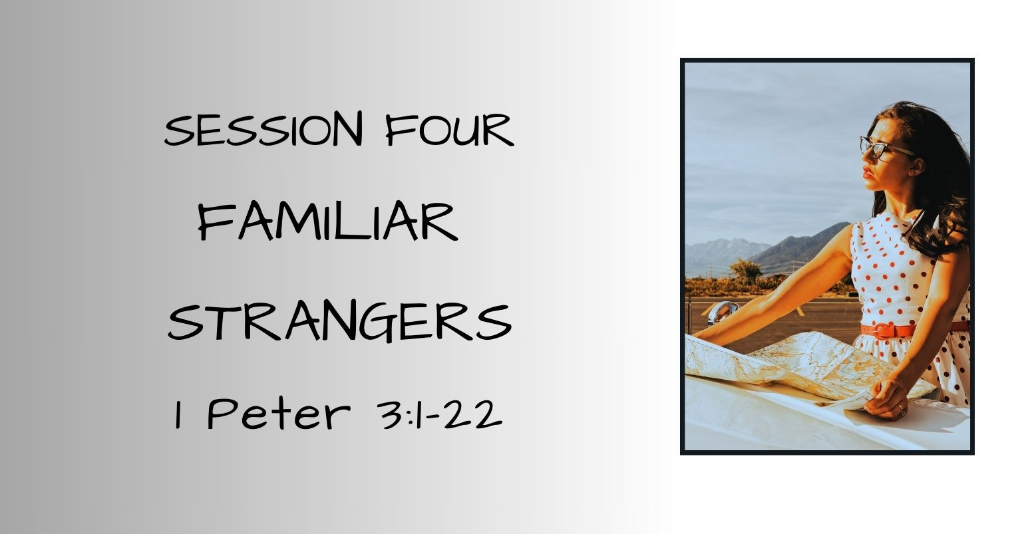

Slide 2
SESSION FOUR – Familiar Strangers
Session 3 – A Promise Between Strangers RECAP
Rahab: Realigned Loyalties
  Chose the unknown, uncertain, and unfamiliar
  Believed the promise of a stranger
  Desired to know the God of Israel
First Peter Chapter Two
  Put off the Old – Put on the New
  Crave the spiritual nourishment of the Word
  Christ is our Cornerstone
  New identity in Christ Jesus
  Conduct above reproach
The Perfect Stranger
  Spotless Lamb of God AND The Good Shepherd

Slide 3
SESSION FOUR – Familiar Strangers
Prelude: Sarah’s Story – Releasing Control
A second-hand relationship with God doesn’t cut it
A submissive exterior can hide a self-serving, controlling interior
Second-guessing God and His perfect timing has consequences
A surrendered heart in relationship with God grows in faith and belief
    “By faith Sarah herself received power to conceive,
    even when she was past the age, since
    she considered Him faithful who had promised.
    Hebrews 11:11 ESV
Notes:
From all appearances, Sarah was the submissive wife – leaving home, family, and everything familiar to accompany her husband, Abram, in his quest to obey and follow God to a promised land. She pretended to be his sister when it was expedient. She played the role of the dutiful wife.
Sarah was getting her “God information” secondhand
Sarah externally was a submissive, reverent wife
In her impatience with God’s timing, she took control
Only when she communicated directly with God did she fully believe
IT’S ONE THING TO HEAR & KNOW GOD’S PROMISES
IT ANOTHER THING ALTOGETHER TO BELIEVE AND CLAIM THOSE PROMISES AS YOUR OWN!

Slide 4
SESSION FOUR – Familiar Strangers
Stranger Relationships: 1 Peter 3:1-7
¹ Likewise, wives, be subject to your own husbands, so that even if some do not obey the word, they may be won without a word by the conduct of their wives, ² when they see your respectful and pure conduct. ³ Do not let your adorning be external--the braiding of hair and the putting on of gold jewelry, or the clothing you wear—⁴ but let your adorning be the hidden person of the heart with the imperishable beauty of a gentle and quiet spirit, which in God's sight is very precious. ⁵ For this is how the holy women who hoped in God used to adorn themselves, by submitting to their own husbands, ⁶ as Sarah obeyed Abraham, calling him lord. And you are her children, if you do good and do not fear anything that is frightening. 1 Peter 3:1-6
WIVES:
Honor your husband
Your external appearance is simply window-dressing
Your inner woman speaks loudest in daily conduct, conversation,
  and attitudes
Defer to your husband UNLESS it is counter to God’s Truth
Live fearlessly – God is in control
Notes:
"¹ Likewise in the same way
– refers back to 1 Peter 2:9-12, he reminds them
1. who they are – a chosen race, a royal priesthood, God’s chosen people, 2:9-10
2. purpose – proclaim the excellencies of God and the salvation through Jesus
3. expected behavior:13-20 –
FEAR GOD (reverence, honor, recognition of His holiness).
LOVE FELLOW-BELIEVERS.
HONOR EVERYONE.
HONOR THE EMPEROR.)
V.1 continued - Wives be subject to your husbands, so that
Submit to God and the authorities He has put in place – be subject to your husband – saved or unsaved – there is no distinction – the testimony of our behavior – our daily conduct & conversation is a witness to the unsaved or backslidden husband
V.1 continued – so that even if some do not obey the word, they may be won without a word by the conduct of their wives (conduct – manner of life displayed regularly)
² when they see (as they observe – watch, view attentively – suggests consistent, ongoing observation) your respectful (reverence)and pure (pure from carnality, chaste, modest, proper, clean, innocent – above reproach) conduct (manner of life, behavior, deportment).
It’s not the outer appearance and adornment that makes the biggest impression & impact – its the spirit exhibited and the heart expressions
God established the family hierarchy in Gen 3- when Eve was deceived by the serpent and ate the fruit – then invited Adam to join her. Adam listened to his wife & chose to disobey God.
Woman’s curse – your desire will be contrary to your husband – but he shall rule over you -Gen 3:16
POINTS
Counterculture for a wife to have a different religion from her husband – the husband’s god was to be the wife’s god: Plutarch, a late first-century Greek historian (AD 46-127), wrote: A wife should not acquire her own friends but should make her husband's friends her own. The gods are the first and most significant friends, for this reason, it is proper for a wife to recognize only those gods whom her husband worships. (early 2nd century “Advice to Bride and Groom” book) ESV Notes
Peter’s instruction for wives to be submissive was different from the current culture of the time – the definition of submission was different
Peter’s instruction for wives is submission to her husband – not all men

Slide 5
SESSION FOUR – Familiar Strangers
Stranger Relationships: 1 Peter 3:1-7
⁷ Likewise, husbands, live with your wives in an understanding way, showing honor to the woman as the weaker vessel, since they are heirs with you of the grace of life, so that your prayers may not be hindered.
Live in love and understanding
Honor your wife
The believing husband and the Christian wife are co-heirs with Christ – equal
  participants in the eternal promises of God
Husbands, keep the communication lines open with God
“However, let each one of you love his wife as himself,
and let the wife see that she respects her husband.”
Ephesians 5:33 ESV
Notes:
⁷ Likewise (in the same way), husbands, live (dwell with, reside together as a family), with your wives in an understanding (informed, general intelligence, moral wisdom, knowledgeable of things lawful and unlawful for Christians) way, showing (bestow, give, apportion, dispense) honor (valuing, deference, reverence, price, precious, dignity) to the woman (wife) as the weaker (lacking strength, weaker – not inferior or less than) vessel (Greek metaphor for body), since they are (fellow, joint participant, co-heirs) heirs with you of the grace of life, so that your prayers may not be hindered (cut into, impeded, cutting off one’s way, getting in the way of, interrupting).
Eph 5:33 Paul talking to husbands – let each one of you love his wife as himself, and let the wife see that she respects her husband (no qualifier here that says he must be worthy of her respect...it’s the position of husband that garners the respect.

Slide 6
SESSION FOUR – Familiar Strangers
Stranger With Purpose: 1 Peter 3:8-17
⁸ Finally, all of you, have unity of mind, sympathy, brotherly love, a tender heart, and a humble mind.
Stranger Behavior:
Unity – Sympathy – Brother Love – Tenderhearted – Humble Mind
Ephesians 4:1-6 ESV
    “Walk in a manner worthy of the calling to which you have been called, with all
    humility and gentleness, with patience, bearing with one another in love,
    eager to maintain the unity of the Spirit in the bond of peace.
    There is one body and one Spirit--just as you were called to the
    hope that belongs to your call—one Lord, one faith, one baptism,
    One God and Father of all, Who is over all and through all and in all.”
Notes:
⁸ Finally, (to sum it all up, this is what it boils down to) all of you (each and everyone of you! No exclusions or exceptions), have unity of mind, sympathy, brotherly love, a tender heart, and a humble mind.’
UNITY – oneness of heart and mind, in agreement
harmonious, be together on this, at the same place at the same time, come to agreement (Strong’s G3675 – homophrōn, from the base (G3674, G5424)
SYMPATHY – suffering, feeling the pain and hurt, and having “compassions” for one another
suffering or feeling in the the same way as another, having a fellow-feeling, mutually commiserative, have compassions one of another (G4835-sympathēs)
BROTHER LOVE – Christian love for each one another; loving like a brother or sister
TENDER HEART – compassionate, kind, easily moved to love, pity, or sorrow
HUMBLE MIND – humility, modesty, having a humble opinion of oneself, humility of attitude, mind, and spirit, having a humble opinion of oneself, a deep sense of one’s (moral) littleness, lowliness of mind (G5012-tapeinophrosynē)

Slide 7
SESSION FOUR – Familiar Strangers
Stranger With Purpose: 1 Peter 3:8-17 Continued
⁹ Do not repay evil for evil or reviling for reviling, but on the contrary, bless, for to this you were called, that you may obtain a blessing. ¹⁰ For "Whoever desires to love life and see good days, let him keep his tongue from evil and his lips from speaking deceit; ¹¹ let him turn away from evil and do good; let him seek peace and pursue it.
Stranger Behavior – Counter-Culture
  No Retribution
  Bless Others
  Guard Your Mouth From Deceit
  Turn Away From Evil
  Diligently Seek And Run After Peace
“Beloved, never avenge yourselves, but leave it to the wrath of God,
for it is written, "Vengeance is mine, I will repay, says the Lord.“
Romans 12:19
Notes:
Romans 12:16 ESV - Live in harmony with one another. Do not be haughty, but associate with the lowly. Never be wise in your own sight.
Romans 12:17 ESV - Repay no one evil for evil, but give thought to do what is honorable in the sight of all.
Romans 12:18 ESV - If possible, so far as it depends on you, live peaceably with all.
Romans 12:19 ESV - Beloved, never avenge yourselves, but leave it to the wrath of God, for it is written, "Vengeance is mine, I will repay, says the Lord."
Romans 12:20 ESV - To the contrary, "if your enemy is hungry, feed him; if he is thirsty, give him something to drink; for by so doing you will heap burning coals on his head."
Romans 12:21 ESV - Do not be overcome by evil, but overcome evil with good.

Slide 8
SESSION FOUR – Familiar Strangers
Stranger With Purpose: 1 Peter 3:8-17 Continued
¹² For the eyes of the Lord are on the righteous, and his ears are open to their prayer. But the face of the Lord is against those who do evil.“
GOD SEES AND HEARS THE RIGHTEOUS
HE TURNS HIS FACE AWAY FROM EVIL
"For I know their works and their thoughts.” Isaiah 66:18 ESV
"Am I a God at hand, declares the LORD, and not a God far away? Can a man hide himself in secret places so that I cannot see him? declares the LORD. Do I not fill heaven and earth? declares the LORD.” Jeremiah 23:23-24 ESV
“The LORD looks down from heaven; he sees all the children of man;
m where he sits enthroned he looks out on all the inhabitants of the earth.”
Psalm 33:13-14 ESV

Slide 9
SESSION FOUR – Familiar Strangers
Stranger With Purpose: 1 Peter 3:8-17 Continued
¹³ Now who is there to harm you if you are zealous for what is good? ¹⁴ But even if you should suffer for righteousness' sake, you will be blessed. Have no fear of them, nor be troubled...
James 1:2 ESV – “Count it all joy, my brothers, when you meet trials of various kinds.”
When – the word assumes it will happen, it wil become reality but the timing is unknown
Trials – G3986 Periasmos: proving, adversity, temptation,
trying, temptation
Notes:
Jeremiah 1:8 ESV - Do not be afraid of them, for I am with you to deliver you, declares the LORD.“
John 14:27 ESV - Peace I leave with you; my peace I give to you. Not as the world gives do I give to you. Let not your hearts be troubled, neither let them be afraid.
Hebrews 13:6 ESV - So we can confidently say, "The Lord is my helper; I will not fear; what can man do to me?"

Slide 10
SESSION FOUR – Familiar Strangers
Stranger With Purpose: 1 Peter 3:8-17 Continued
¹⁵ but in your hearts honor Christ the Lord as holy, always being prepared to make a defense to anyone who asks you for a reason for the hope that is in you; yet do it with gentleness and respect, ¹⁶ having a good conscience, so that, when you are slandered, those who revile your good behavior in Christ may be put to shame.
¹⁷ For it is better to suffer for doing good, if that should be God's will, than for doing evil.
Defense – G627 apologia: to give an answer, defend a position, belief, or truth
Argument or defense statement as made by a lawyer
Apologetics – defense of the faith
Philippians 1:7, 2 Timothy 4:16
Notes:
Philippians 1:7 ESV - It is right for me to feel this way about you all, because I hold you in my heart, for you are all partakers with me of grace, both in my imprisonment and in the defense and confirmation of the gospel.
2 Timothy 4:16 ESV - At my first defense no one came to stand by me, but all deserted me. May it not be charged against them!

Slide 11
SESSION FOUR – Familiar Strangers
The Perfect Stranger: 1 Peter 3:18-22
¹⁸ For Christ also suffered once for sins, the righteous for the unrighteous, that he might bring us to God, being put to death in the flesh but made alive in the spirit, in which he went and proclaimed to the spirits in prison, ²⁰ because they formerly did not obey, when God's patience waited in the days of Noah, while the ark was being prepared, in which a few, that is, eight persons, were brought safely through water.
The Big Picture:
Noah & family strangers surrounded by hostile unbelievers
Noah was righteous in the midst of a wicked world
Noah witnessed boldly to those around him
Noah knew judgment was coming
Noah proclaimed judgment and repentance
- From Wayne Grudim (NT Commentary Vol. 17, IVP, Logos
Notes:
Much debated passage:
Issues (Wayne Grudim)
Who are the spirits in prison?
Unbelievers who have died?
OT believers who have died?
Fallen angels?
What did Christ preach?
Second chance for repentance?
Completion of redemptive work?
Final condemnation?
When did He preach?
In the days of Noah?
Between His death and resurrection?
After His resurrection?
NO definitive answers

Slide 12
SESSION FOUR – Familiar Strangers
The Perfect Stranger: 1 Peter 3:18-22
²¹ Baptism, which corresponds to this*, now saves you, not as a removal of dirt from the body but as an appeal to God for a good conscience, through the resurrection of Jesus Christ, ²² who has gone into heaven and is at the right hand of God, with angels, authorities, and powers having been subjected to him."
reference to passing through the flood waters
The Waters of Baptism are symbolic of the washing away of our sins and a picture
of the purchase of our redemption by Jesus’ death, burial, and
resurrection.
The flood waters were the cleansing agent God used to wash away the
wickedness of the world.

Slide 13
SESSION FOUR – Familiar Strangers
The Perfect Stranger: 1 Peter 3:18-22
“The LORD saw that the wickedness of man was great in the earth, and that every intention of the thoughts of his heart was only evil continually. And the LORD regretted that he had made man on the earth, and it grieved him to his heart.
Genesis 6:5-6
“But Noah found favor in the eyes of the LORD. ... Noah was a righteous man, blameless in his generation. Noah walked with God.” Genesis 6:8-9
“No matter how ungodly the environment you may be in,
God will always find you and walk with you.”
Henry T. & Richard Blackaby, Experiencing God Day By Day

Slide 14
