Slide 1
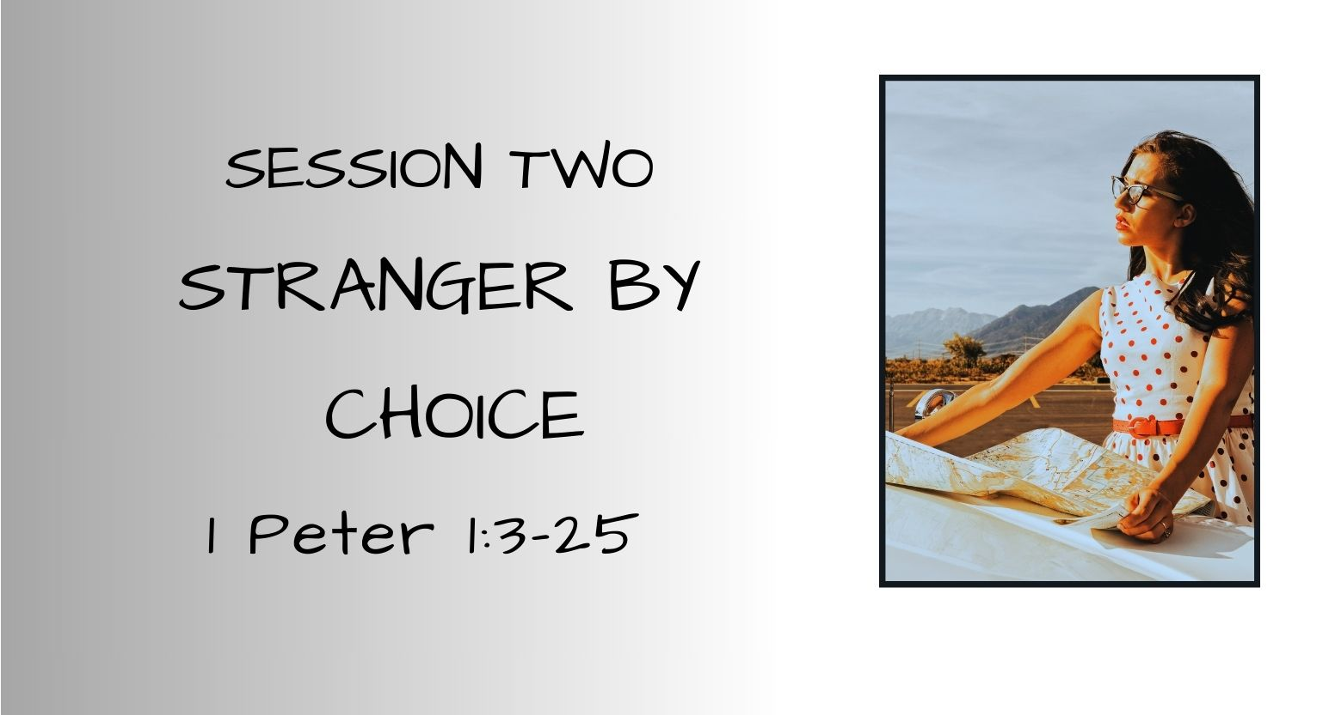

Slide 2
SESSION ONE RECAP:
Back Story:
  Author: Peter, the Apostle of Christ – Rome, A.D. 62-63
  Written To: Jewish and Gentile Christians sojourning throughout Roman provinces
  Purpose: To Engage, Ensure, Equip, & Encourage believers living as strangers in strange and hostile lands
1 Peter 1:1-2
  To “Elect Exiles” = Chosen (by God) Sojourners (temporary residents)
  Foreknown by God the Father
  Active & ongoing sanctification and transformation by God the Holy Spirit
  Redeemed and sanctified by God the Son, Jesus Christ
  God is the Multiplier of our grace & peace

Slide 3
SESSION TWO – STRANGER BY CHOICE
Prelude: Ruth’s Story
Strangers – Naomi, Elimelech (husband), two sons (Mahlon and Chilion)
  Choice made in disobedience and unbelief
Stranger – Ruth
  Choice made in love, faith, and hope
  “But Ruth said, "Do not urge me to leave you or to return from following you.
  For where you go I will go, and where you lodge I will lodge. Your people shall be my people, and your God my God. Where you die I will die, and there will I be buried. May the LORD do so to me and more also if anything but death parts me from you.“
  And when Naomi saw that she was determined to go with her, she said no more.” - Ruth 1:16-18 ESV

Slide 4
SESSION TWO – STRANGER BY CHOICE
The Stranger’s Living Hope– 1 Peter 1:3 – 5
³ Blessed be the God and Father of our Lord Jesus Christ! According to his great mercy, He has caused us to be born again to a living hope through the resurrection of Jesus Christ from the dead, ⁴to an inheritance that is imperishable, undefiled, and unfading, kept in heaven for you, ⁵who by God's power are being guarded through faith for a salvation ready to be revealed in the last time.
Born To A Living Hope – v. 3 (Ephesians 2:1-5)
  An Inheritance: Imperishable, Undefiled, & Unfading Inheritance –
  Reserved & Waiting v. 4
Guarded by God’s Power – Working In Concert with Your Faith v. 5
Notes:
Ephesians 2:1-10 – I WAS A DEAD MAN WALKING – BROUGHT TO LIFE BY JESUS
“And you were dead in the trespasses and sins in which you once walked, following the course of this world, following the prince of the power of the air, the spirit that is now at work in the sons of disobedience--among whom we all once lived in the passions of our flesh, carrying out the desires of the body and the mind, and were by nature children of wrath, like the rest of mankind.
But God, being rich in mercy, because of the great love with which he loved us, even when we were dead in our trespasses, made us alive together with Christ--by grace you have been saved--and raised us up with him and seated us with him in the heavenly places in Christ Jesus, so that in the coming ages HE might show the immeasurable riches of His grace in kindness toward us in Christ Jesus.
For by grace you have been saved through faith. And this is not your own doing; it is the gift of God, not a result of works, so that no one may boast.”

Slide 5
SESSION TWO – STRANGER BY CHOICE
The Stranger’s Living Hope– 1 Peter 1:6 – 12
⁶ In this you rejoice, though now for a little while, if necessary, you have been grieved by various trials, ⁷ so that the tested genuineness of your faith--more precious than gold that perishes though it is tested by fire--may be found to result in praise and glory and honor at the revelation of Jesus Christ.
⁸ Though you have not seen him, you love him. Though you do not now see him, you believe in him and rejoice with joy that is inexpressible and filled with glory, ⁹ obtaining the outcome of your faith, the salvation of your souls.
¹⁰ Concerning this salvation, the prophets who prophesied about the grace that was to be yours searched and inquired carefully, ¹¹ inquiring what person or time the Spirit of Christ in them was indicating when he predicted the sufferings of Christ and the subsequent glories. ¹² It was revealed to them that they were serving not themselves but you, in the things that have now been announced to you through those who preached the good news to you by the Holy Spirit sent from heaven, things into which angels long to look.
  Joy, Faith, and Believing in Times of Trials & Testing v. 6-9
  Salvation Foretold Has Come to Pass v. 10-12

Slide 6
SESSION TWO – STRANGER BY CHOICE
The Stranger’s Call to Holiness– 1 Peter 1:13 – 16
¹³ Therefore, preparing your minds for action, and being sober-minded, set your hope fully on the grace that will be brought to you at the revelation of Jesus Christ. ¹⁴ As obedient children, do not be conformed to the passions of your former ignorance, ¹⁵ but as he who called you is holy, you also be holy in all your conduct, 16 since it is written, "You shall be holy, for I am holy."
Therefore, Prepare! v. 13 – 16
  Ready to act v. 13 (I Kings 18:46)
  Mentally sound and alert v. 13 (1 Thessalonians 5:8)
  Confidently expectant v. 13
  Obedient v. 14 (1 John 2:17)
  Unfettered from the passions of your past v. 14 (Romans 12:2)
  Purity in Conduct and Lifestyle v. 15 (Exodus 31:13, )
  Reverential recognition and remembrance that you serve The Holy God
  v. 16 (Leviticus 20:7, 26)
Notes:
And the hand of the LORD was on Elijah, and he gathered up his garment and ran before Ahab to the entrance of Jezreel. - 1 Kings 18:46 ESV
But since we belong to the day, let us be sober, having put on the breastplate of faith and love, and for a helmet the hope of salvation. - 1 Thessalonians 5:8 ESV
And the world is passing away along with its desires, but whoever does the will of God abides forever. - 1 John 2:17 ESV
Do not be conformed to this world, but be transformed by the renewal of your mind, that by testing you may discern what is the will of God, what is good and acceptable and perfect. - Romans 12:2 ESV
Exodus 31:14 (Speaking of keeping the Sabbath) This will be a sign between Me and you for the generations to come, so you may know that I am the LORD, who makes you holy.
Consecrate yourselves, therefore, and be holy, for I am the LORD your God. - Leviticus 20:7 ESV
You shall be holy to me, for I the LORD am holy and have separated you from the peoples, that you should be mine. - Leviticus 20:26 ESV

Slide 7
SESSION TWO – STRANGER BY CHOICE
The Stranger’s Call to Holiness– 1 Peter 1:15 – 16
¹⁵ but as He who called you is holy, you also be holy in all your conduct, ¹⁶ since it is written, "You shall be holy, for I am holy.“
Holiness: Set apart, separated to God, pursuing holiness through the ongoing sanctifying work of the Holy Spirit in us, which requires our cooperation. Set apart from the ordinary for the purpose of glorifying God.
“The idea of holiness for God’s people includes ...a specifically moral sense of separation from evil and dedication to a life of righteousness.” (Wayne Grudem, Tyndale New Testament Commentaries Vo.l 17))
  “ I am the LORD, who brought you up out of Egypt to be your God; therefore be holy, because I am holy. Leviticus 11:45 ESV
  “Be holy because I, the LORD your God, am holy.” Leviticus 20:7 ESV
  “For God has not called us for impurity, but in holiness. Therefore, whoever
  disregards this, disregards not man but God, who gives His Holy Spirit to you.
  1 Thessalonians 4:7-8 ESV
  “Strive for peace with everyone, and for the holiness without which no one
  will see the Lord.” Hebrews 12:14 ESV

Slide 8
SESSION TWO – STRANGER BY CHOICE
The Stranger’s Call to Holiness– 1 Peter 1:17-19
¹⁷And if you call on Him as Father who judges impartially according to each one's deeds, conduct yourselves with fear throughout the time of your exile, ¹⁸ knowing that you were ransomed from the futile ways inherited from your forefathers, not with perishable things such as silver or gold, ¹⁹ but with the precious blood of Christ, like that of a lamb without blemish or spot.
As a child copies her dad to please him, so we should emulate our Father- to please and bring joy to Him
Conduct yourself with “fear” – recognition of power, awe, reverence, living in obedience because you fear God’s discipline and displeasure
Know you’re no longer a citizen of this strange land – you are a sojourner – you’re here on a temporary visa – don’t live like a citizen – you don’t belong here
Ransomed & Redeemed not by anything of this earth that will
decay, deconstruct, or decompose BUT by the blood of the
spotless Lamb of God, Jesus
Notes:
Fear – G5401 phobos – terror, dread, or reverence – fear of discipline for disobedience
Romans 8:15 – for you did not receive the spirit of slavery to fall back into fear, buy you have received the Spirit of adoption as sons, by whom we cry, “Abba! Father!”
1 John 4:18 – There is no fear in love, but perfect love casts out fear. For fear has to do with punishment, and whoever fears has not been perfected in love. But when Christ appeared as a high priest of the good things that have come, then through the greater and more perfect tent (not made with hands, that is, not of this creation) - Hebrews 9:11 ESV
he entered once for all into the holy places, not by means of the blood of goats and calves but by means of his own blood, thus securing an eternal redemption. - Hebrews 9:12 ESV
For if the blood of goats and bulls, and the sprinkling of defiled persons with the ashes of a heifer, sanctify for the purification of the flesh, - Hebrews 9:13 ESV
how much more will the blood of Christ, who through the eternal Spirit offered himself without blemish to God, purify our conscience from dead works to serve the living God. - Hebrews 9:14 ESV

Slide 9
SESSION TWO – STRANGER BY CHOICE
The Perfect Stranger – 1 Peter 1:19-22
¹⁹ but with the precious blood of Christ, like that of a lamb without blemish or spot. ²⁰ He was foreknown before the foundation of the world but was made manifest in the last times for the sake of you ²¹ who through Him are believers in God, who raised Him from the dead and gave Him glory, so that your faith and hope are in God.
  Perfect Sacrifice
  Eternal God
  Savior of the World
  Defeater of Satan, Sin, & Death
  Giver of Life Without End
  The Living Word
  Perfect Example of Holy Living in a Strange Land
Notes:
Jesus – without beginning – without an end – eternal God

Slide 10
SESSION TWO – STRANGER BY CHOICE
The Perfect Stranger – 1 Peter 1:22-25
“²² Having purified your souls by your obedience to the truth for a sincere brotherly love, love one another earnestly from a pure heart, ²³ since you have been born again, not of perishable seed but of imperishable, through the living and abiding word of God;
²⁴ for ‘All flesh is like grass and all its glory like the flower of grass.
The grass withers, and the flower falls,
²⁵ but the Word of the Lord remains forever.’ And this Word is the good news that was preached to you.”
Notes:
Because of OUR PERFECT STRANGER – JESUS CHRIST and His sacrifice on the cross
Because God chose us and sent His Son to REDEEM US
Because the Holy Spirit is at work in us to transform and equip us
Because we said “yes, LORD” and surrendered our mind, heart, and spirit -
– we participate in our Ongoing sanctification
- Through our Obedience to the faith
- As we grow in holiness and purity (ongoing cleansing-sanctifying process) We grow in our love for one another from – 1:2 – sprinkling with his blood (leprosy)
Born of living indestructible seed
1 John 2:15 ESV -17 Do not love the world or the things in the world. If anyone loves the world, the love of the Father is not in him. For all that is in the world--the desires of the flesh and the desires of the eyes and pride of life--is not from the Father but is from the world.
And the world is passing away along with its desires, but whoever does the will of God abides forever.
JESUS – THE LIVING WORD:
John In the beginning was the Word, and the Word was with God, and the Word was God.
He was in the beginning with God.
1:1-5 All things were made through him, and without him was not any thing made that was made.
The light shines in the darkness, and the darkness has not overcome it.
We ARE STRANGERS IN THIS STRANGE WORLD – TEMPORARY SOJOURNERS
We may not know the way through this journey of life – but our Savior our Perfect Stranger is our guiding light and there is no darkness that can overcome Him

Slide 11
Key verse: 1 Peter 1:3-5 ESV –³ Blessed be the God and Father of our Lord Jesus Christ! According to his great mercy, He has caused us to be born again to a living hope through the resurrection of Jesus Christ from the dead, ⁴to an inheritance that is imperishable, undefiled, and unfading, kept in heaven for you, ⁵who by God's power are being guarded through faith for a salvation ready to be revealed in the last time.
Notes:
CLOSING PRAYER
I was a resident of a land filled with “dead men walking” – dead in my trespasses and sin
BUT Jesus – my living hope changed that for all eternity
I am alive in Christ – held in the Father’s hand until in that last day when the fullness of my salvation and the perfection that the Holy Spirit has been working so diligently to bring to completion is fully realized and I take possession of the indestructible inheritance in Christ Jesus that waits for me

Slide 12
